Slide 1
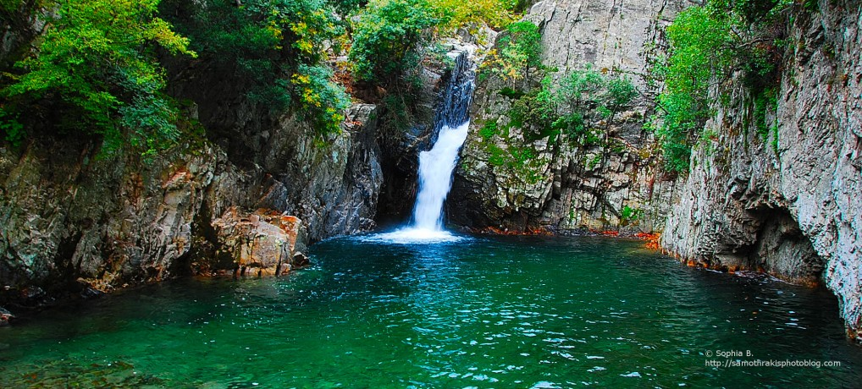


Visions for Samothraki
Marina Fischer-Kowalski, Lazaros Xenidis, Panos Petridis,
Mary Pitiakoudi
Sustainable Samothraki NGO

Slide 2
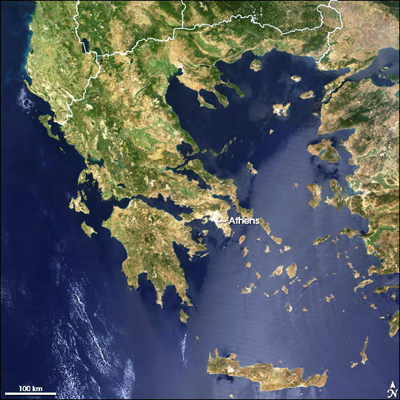
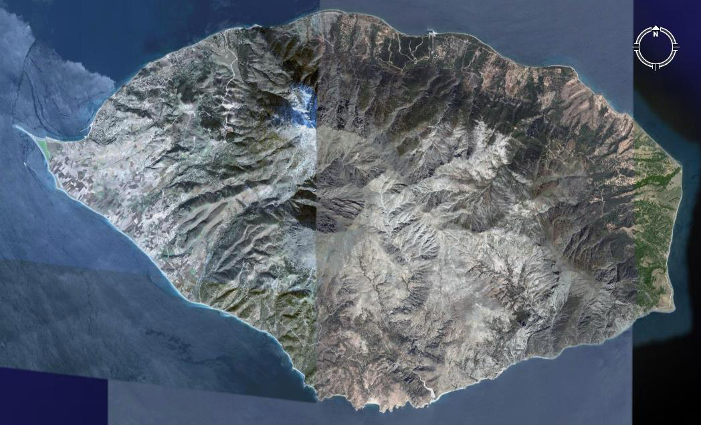
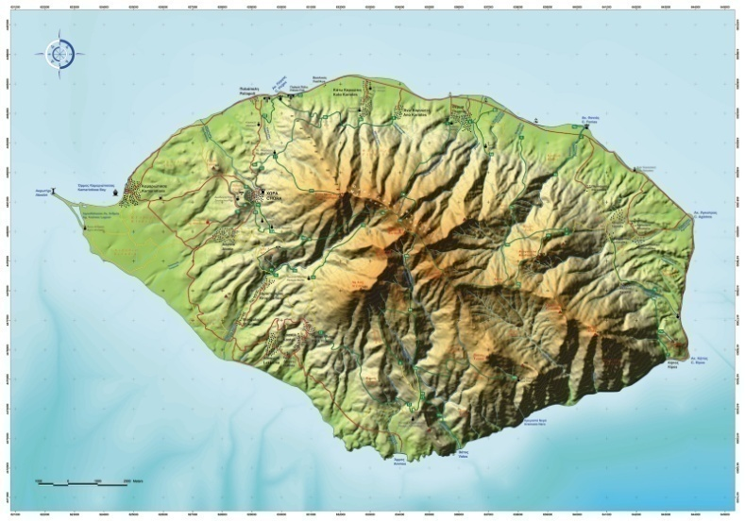
The island of Samothraki
Location : North-eastern Aegean Sea
Total Surface : 178 km2
Highest Peak :1611 m

Slide 3
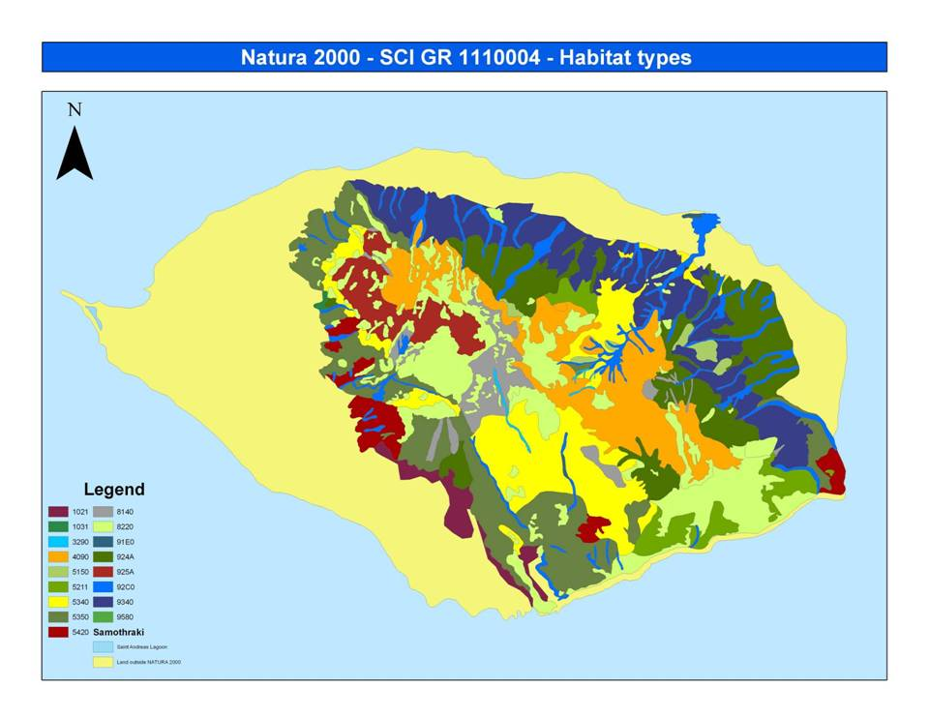
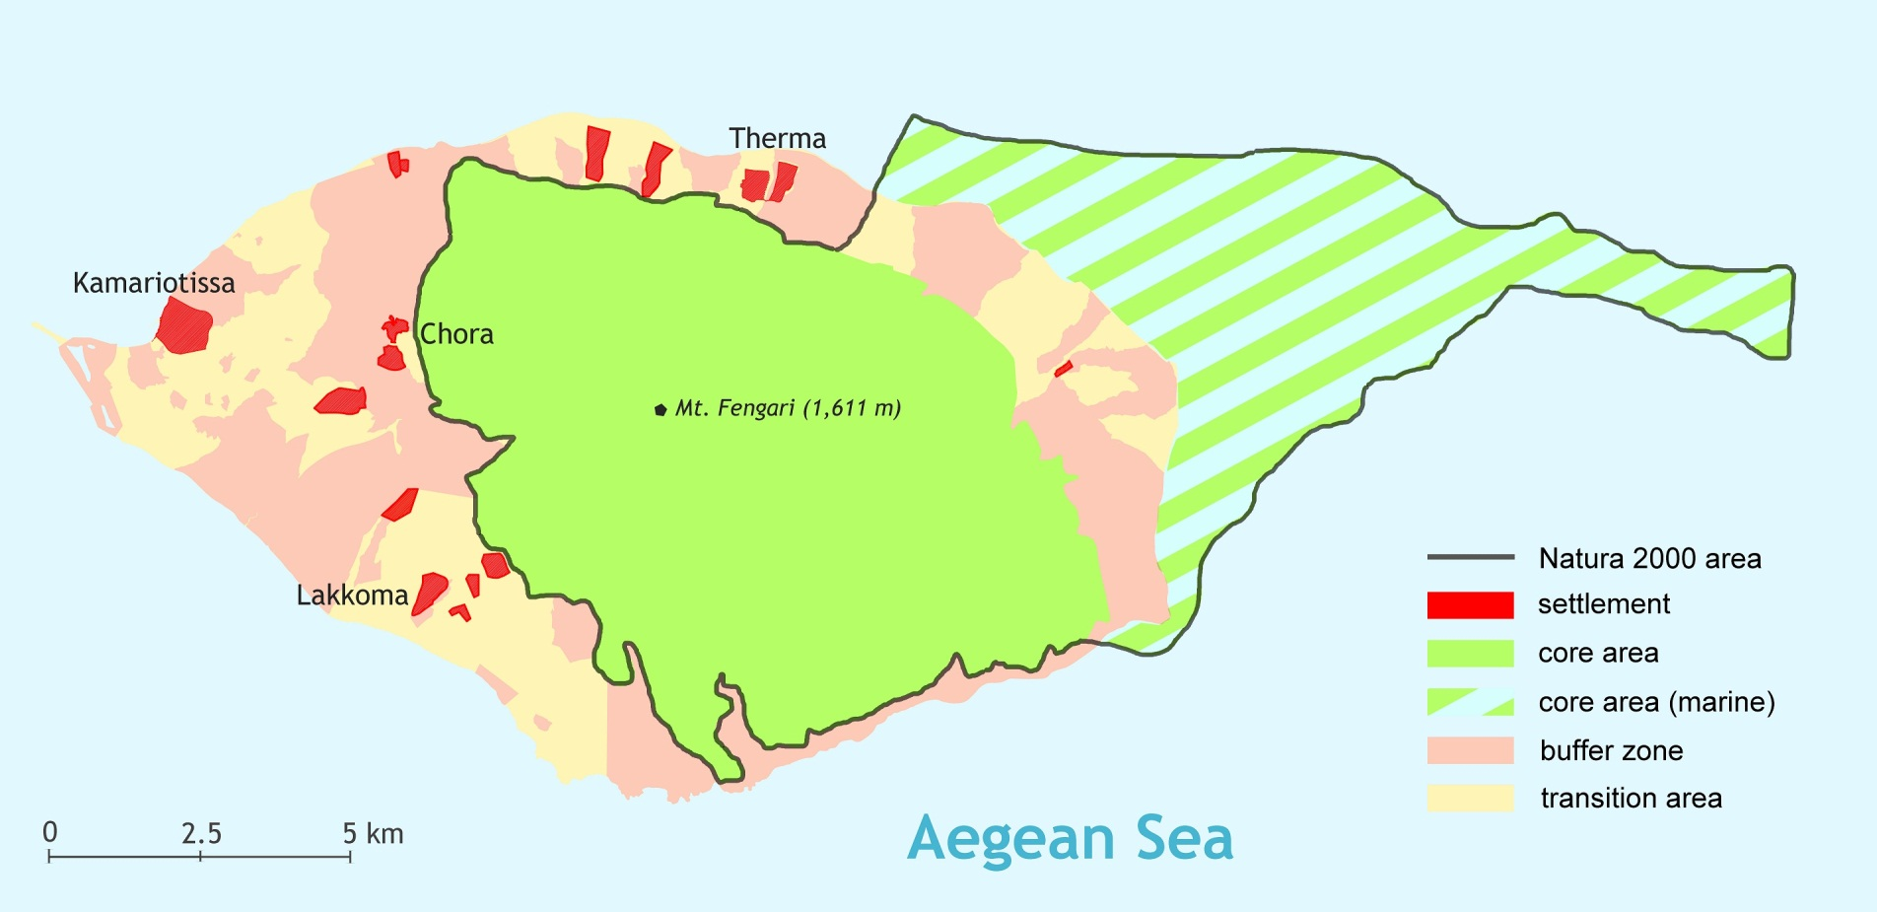
NATURA 2000 ZONATION & HABITAT TYPES
NATURA 2000 Area established
covering 80% of the island
containing 15 habitat types
PROPOSED ZONATION
Core area - conservation and monitoring of minimally disturbed ecosystems
Buffer zone - education, scientific research and experiments
Transition area - research, tourism and recreation, other activities

Slide 4
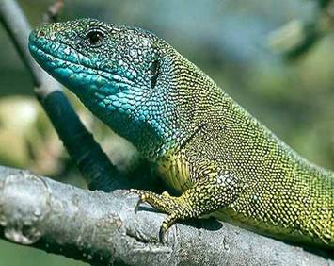
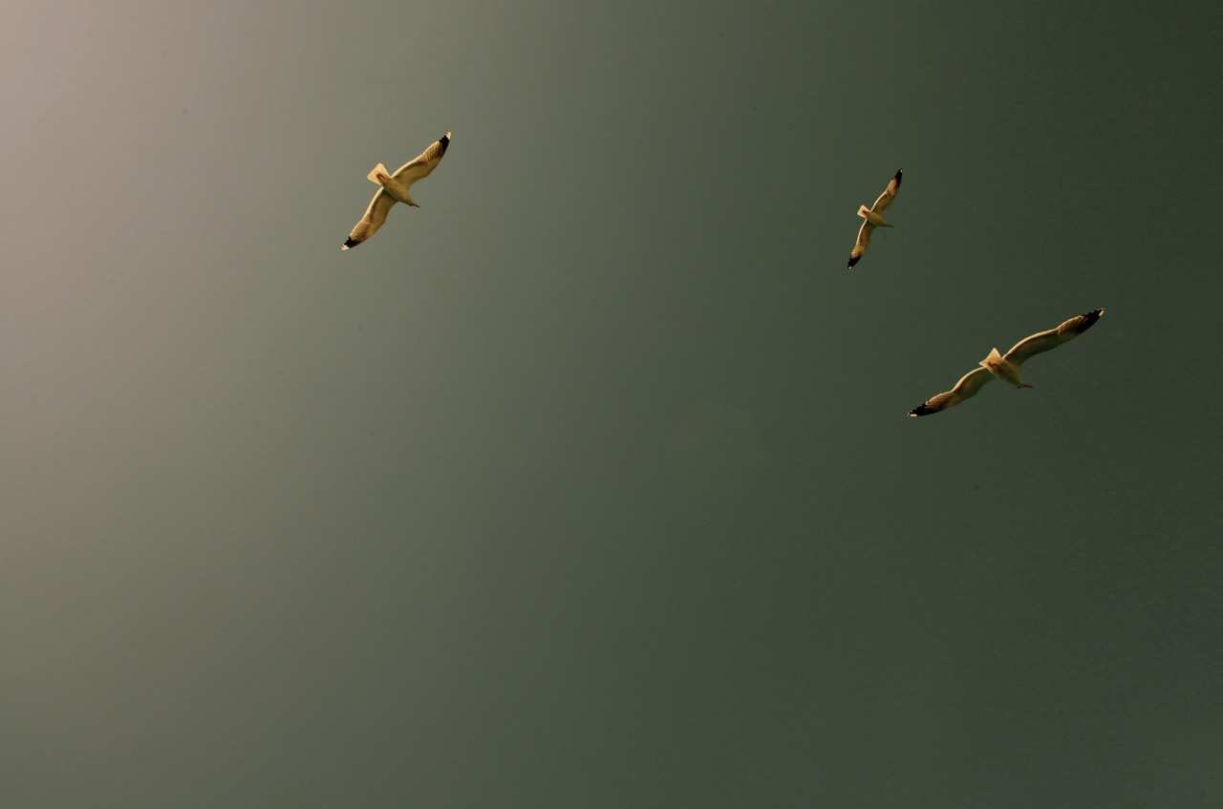
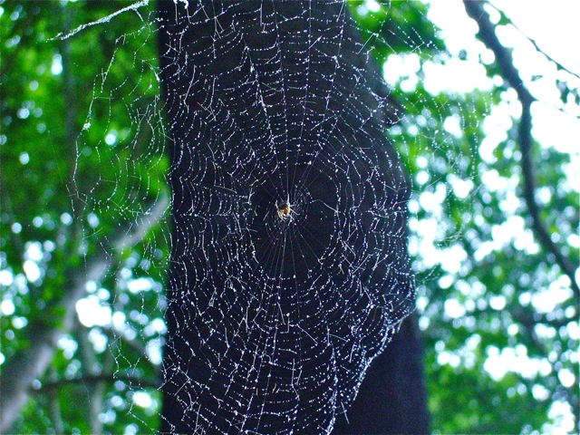
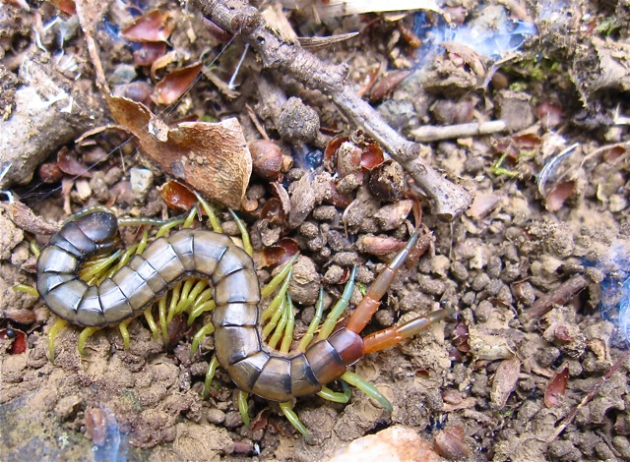
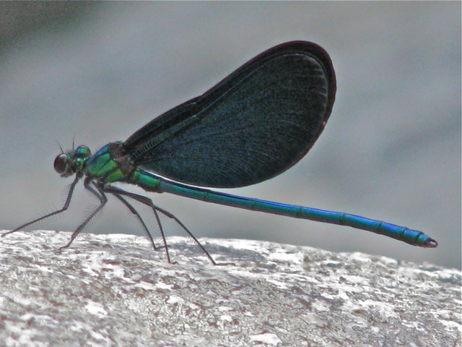
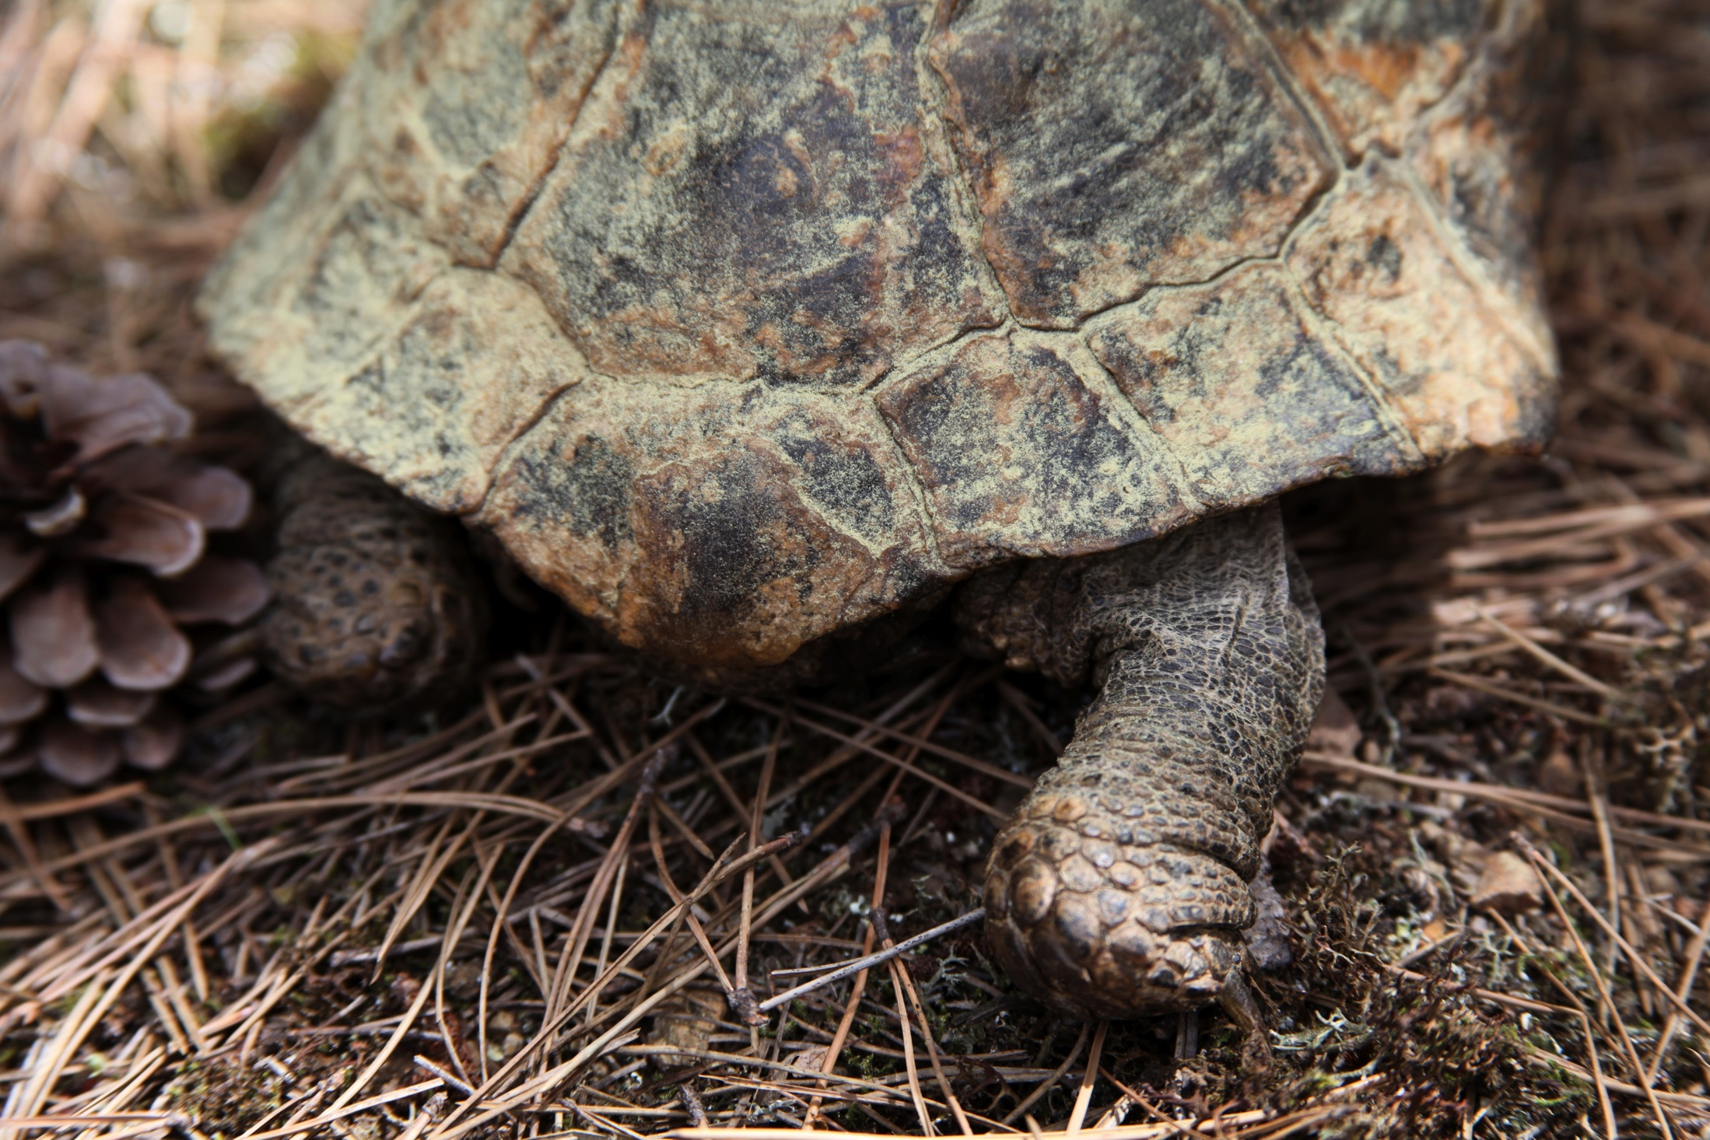
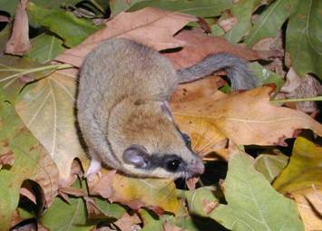
Natural Environment
Fauna
14 mammals species
27 reptiles and amphibians species
156 bird species under various presence states

Slide 5
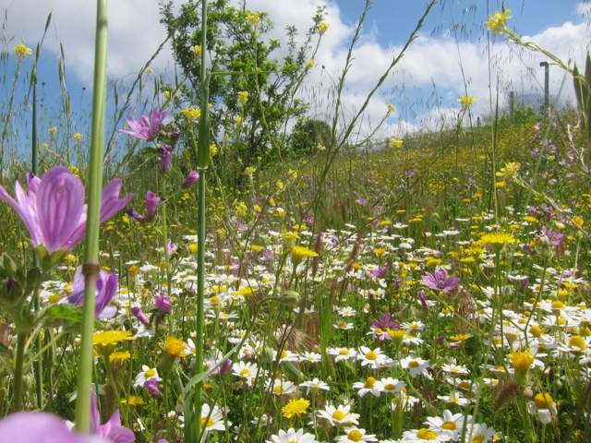
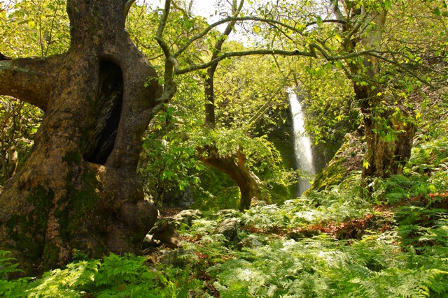
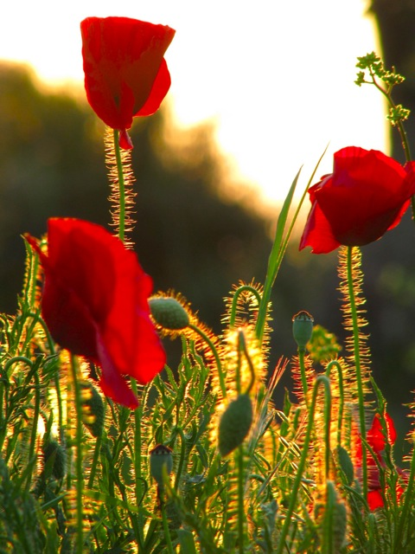
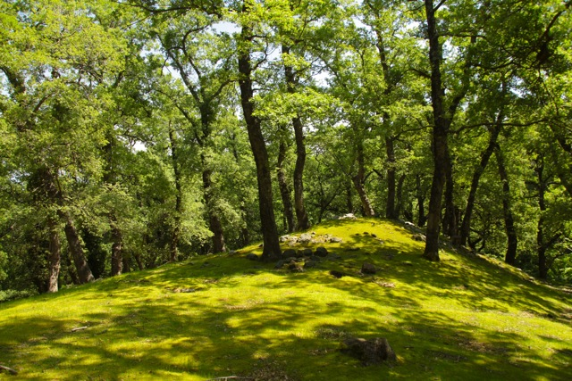
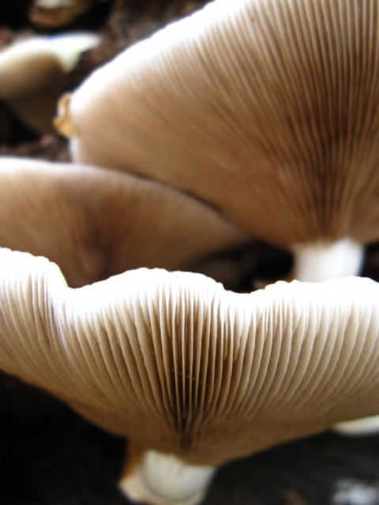
Natural Environment
Flora
62 tree and bush species
394 plant species, many of them endemic
One of the last remaining old growth oak forests in high altitudes (Quercus frainneto)
Riverine - Alluvial forest of Platanus Orientalis, largest in Greece next to the sea

Slide 6
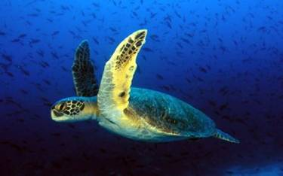
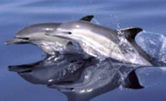
Marine Environment
Very few data on the marine environment
Posidonia oceanica sea beds
Deep sea trenches up to 1000m undiscovered
Presence of marine mammals whales, dolphins, monk seals and sea turtle Carreta carreta
Plans for the creation of a marine reserve existing

Slide 7
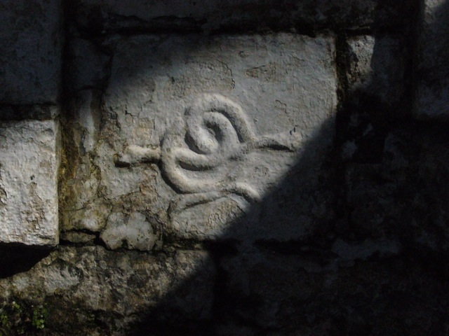
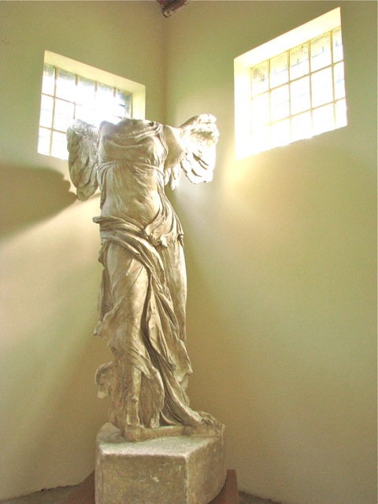
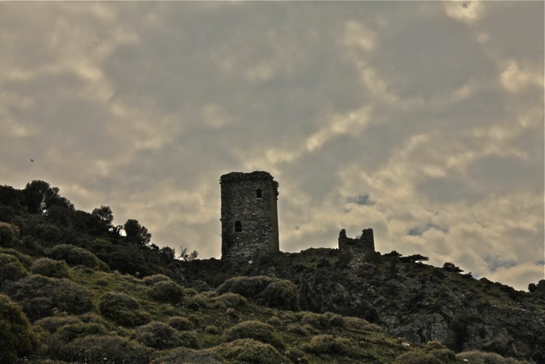
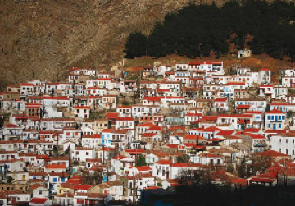
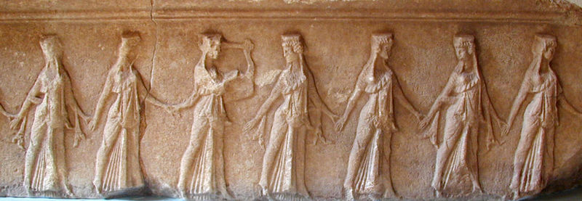
Cultural Heritage
Samothraki inhabited since prehistoric times (6000 BC)
Cultural heritage sites (Chora)
Sanctuary of Great Gods
Nike Statue in Louvre Museum

Slide 8
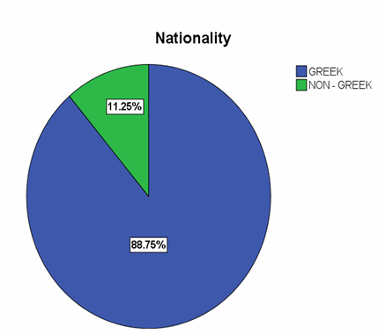
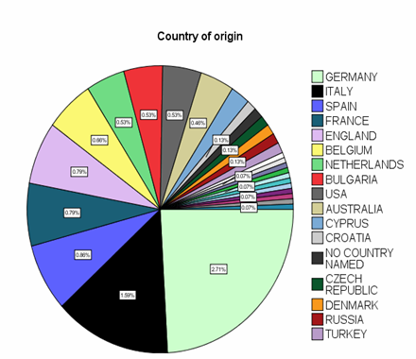
Socioeconomic Utilization
2840 permanent residents: 60% economically inactive, 45% in primary sector (livestock, agriculture, fishery), 40% in services (mainly tourism), 15% manufacture
About 5000 secondary residents, utilizing their secondary homes seasonally, staying an average of 3 weeks
35000 tourists annually, 25% weekend tourism, 50% staying a week, 25% longer
About 5000 seasonal workers, mainly in tourism, staying an average of 5 weeks

Slide 9
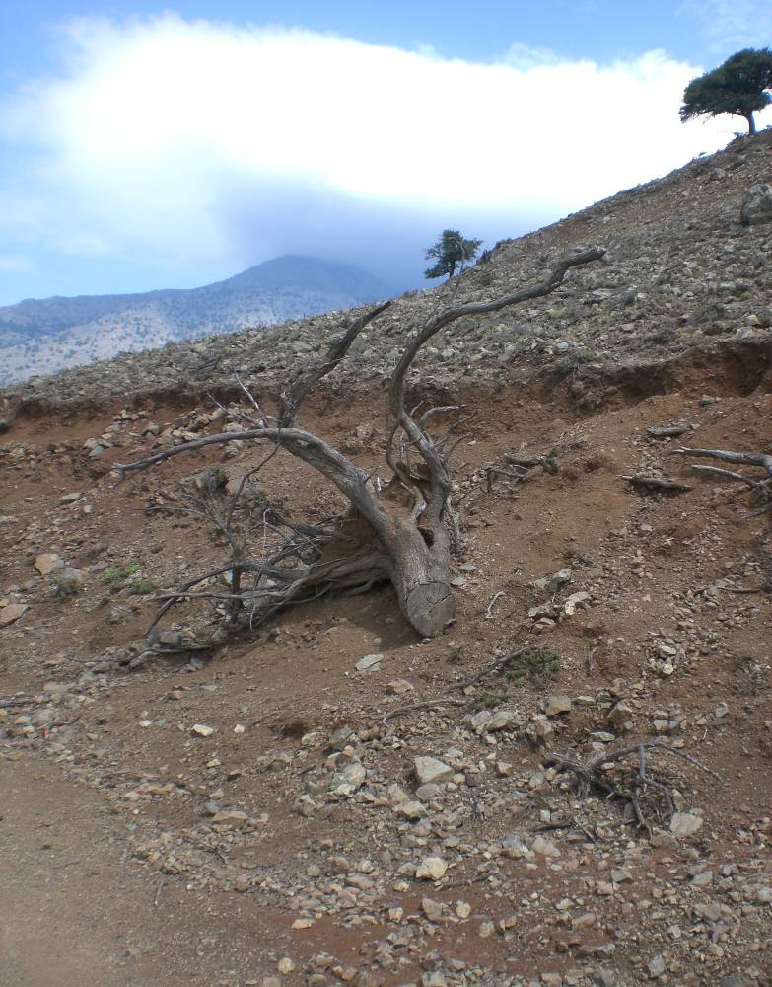
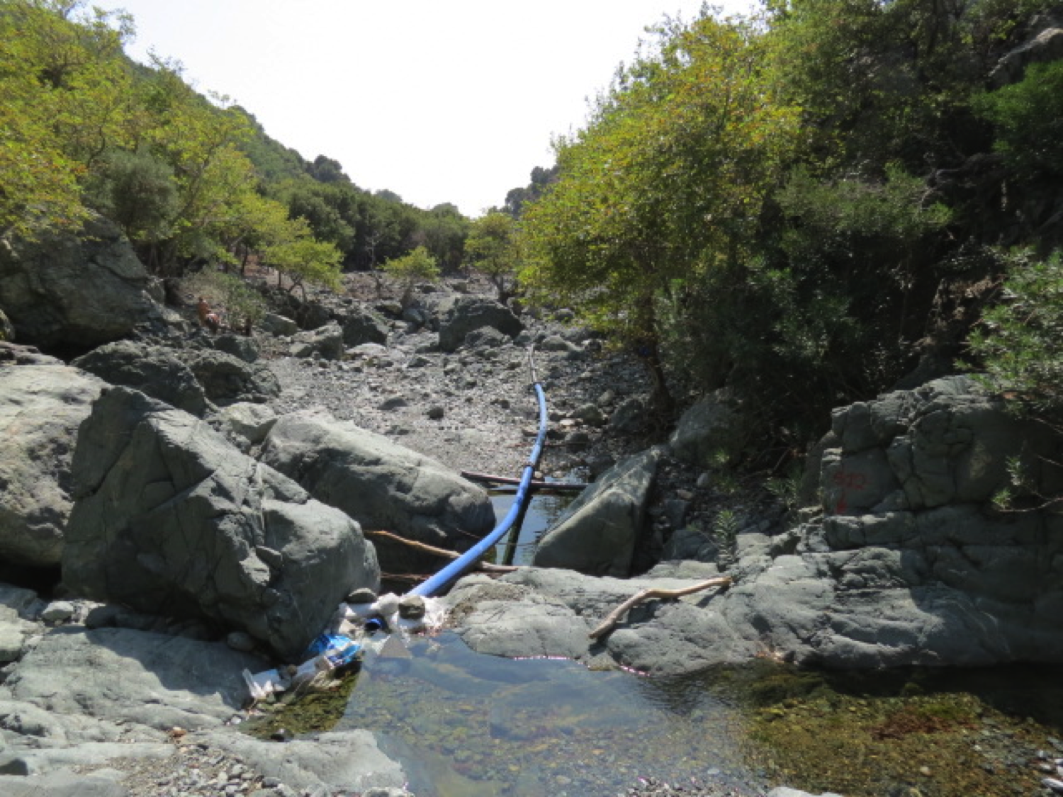
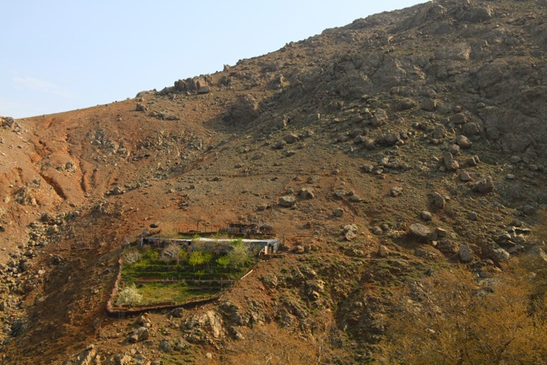
Key Pressures on the Environment
Overgrazing (80,000 goats and sheep) → loss of soils, erosion
Uncontrolled freshwater extraction → pressure on estuaries
High dependence on imports → waste accumulation
Inadequate water and waste management
Overfishing
Deforestation due to increase demand on firewood
Loss of Biodiversity

Slide 10
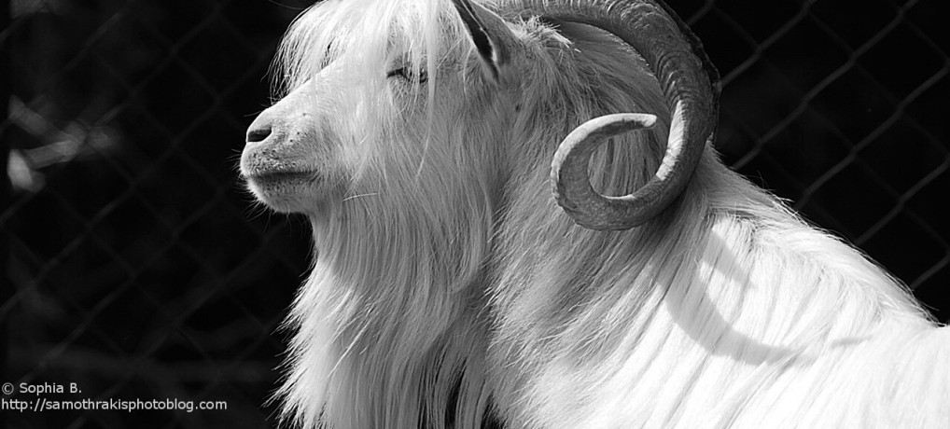
Example : Overgrazing
Environmental challenge:
  Overgrazing, soil erosion
  High livestock numbers (~80.000) sustained by EU subsidies
Framework conditions:
  Possible reduction of subsidies in 2013, threatening farmers’ income
Goal/Proposed solution:
  Reduce livestock by 80% while maintaining farmers’ income
  Better utilisation of goats through prolonged value chains
  Shift towards high value organic agriculture
  First step :Inform Livestock owners for the new CAP policy
  Create synergy and cooperation in between the primary sector and other stakeholders

Slide 11

Sustainable Samothraki
A complex Puzzle
Marrying the brilliance, lessons, and knowledge of our ancestors with the innovation of our youth, technology, and the access to information that our grandparents couldn’t conceive possible, to create a healthy unified world.
PowerHouse Growers
http://www.powerhousegrowers.com/

Slide 12
Timeline
2007: Perceived problem/potential solution
2008: Socioeconomic assessment, stakeholder interviews
2009: First presentations of the results, open discussions
2010: Decision of Mayor and municipal council to prepare an application with support from Institute of Social Ecology
2011: Application delivered to UNESCO
2012: First reaction from UNESCO highly positive, but missing: a clear management plan.
2012: Decision on an operational management by the commune. Develop small specific projects towards sustainable development.
2013: NGO “Sustainable Samothraki“ is born, the NGO that will assume the management of the future Samothraki BR.
2013: (Sept.) Resubmission to UNESCO
2014: First reactions: unclear protection status (in relation to the Natura 2000 areas). Practical establishment/ start off with concrete projects as “BR candidate”…

Slide 13
Conclusions from the feasibility study:
Sustainable development opportunities
Samothraki holds a great potential to serve as a model site for promoting sustainable development.
Long history of involvement of Samothraki in national and international projects in the direction of sustainable development.
The inclusion of Samothraki in the World Network of Biosphere Reserves would be an opportunity to place all efforts into a broader framework by promoting cooperation and information transfer and strengthening the direction of Samothraki towards sustainable development.

Slide 14
Creation of Synergy
Scientists
NGO
Local Stakeholders
State & Local Authorities

Scientists
NGO
Local Stakeholders
State & Local Authorities

Slide 15
Step by Step Process
Our Education
Create our legal structure
Funding based on Independency (social capital)
Identify and connect with key influence stakeholders
Create Synergies
Initiate the Creation of an ESD center
Enjoy the Process!

Slide 16
ESD as a Connective Tissue
Scientists:
Analyze
Research
Monitoring
Propose Solutions
NGO
Management
Coordination
Communication
Organization
New Social Cooperatives
TOURISM
Information
Connection with the Locals
Local Stakeholders
Key influence Individuals
Cooperation
Connection
Trust
Conflict Resolution
Local Authorities
Law Enforcement
Legal Procedures
Cooperation

Slide 17
Education for Sustainable development
Achieving Sustainable Development on a mountainous Island. An Erasmus course April 30 – May 12, 2014 Organized by the Institute of Social Ecology, Vienna. Responsible Prof. Marina Fischer-Kowalski (3 years)
Introduction to Strategic Sustainable Development
3 months distance course at Blekinge Institute of Technology, Sweden
Conflict Resolution education planned with the support of the Aristoteleio University
Amfissa Erasmus IP Summer School for ESD
Participation in the Euromab Conference 2013
Course for Island and Coastal Area Biosphere Reserves Managers
Island of Jeju, Republic of Korea (WN of Island and Coastal Area BRs

Slide 18
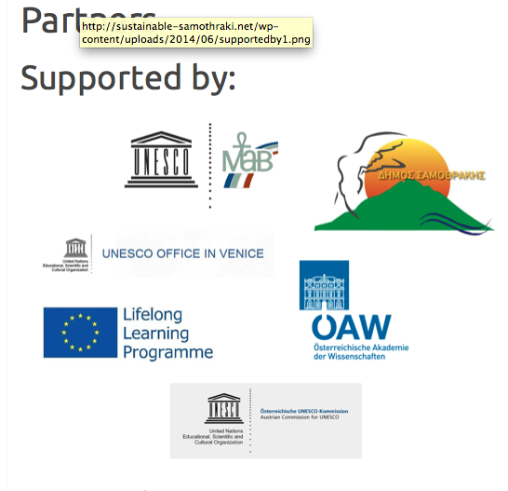
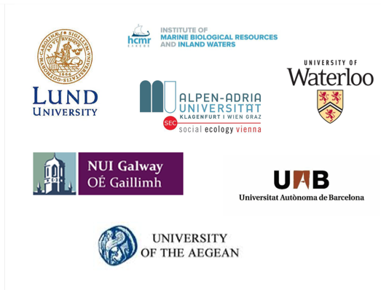


Partnerships
New Partnerships

Slide 19
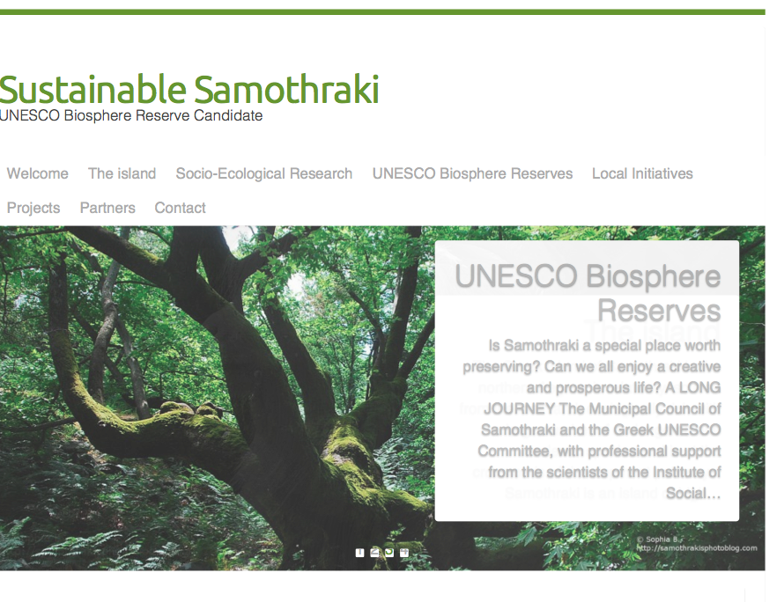
Our New Site!!!
www.sustainable-samothraki.net
email: sustainablesamothraki@gmail.com

Slide 20
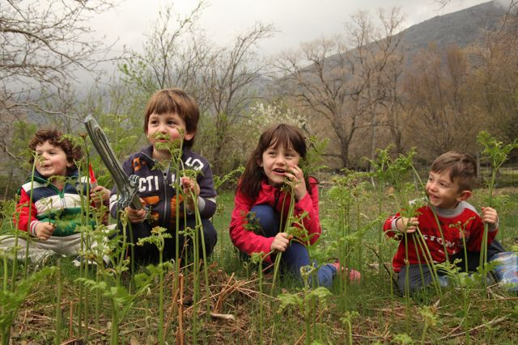
Thank you all !
Sustainable Samothraki

