Slide 1



Summer school, 6-19 July 2014, Amfissa, Hellas
ESD in Protected Areas and Biosphere Reserves
The Olympus National Park Management Agency
Savvas Vasileiadis
Guide for National Parks and Protected Areas

Slide 2
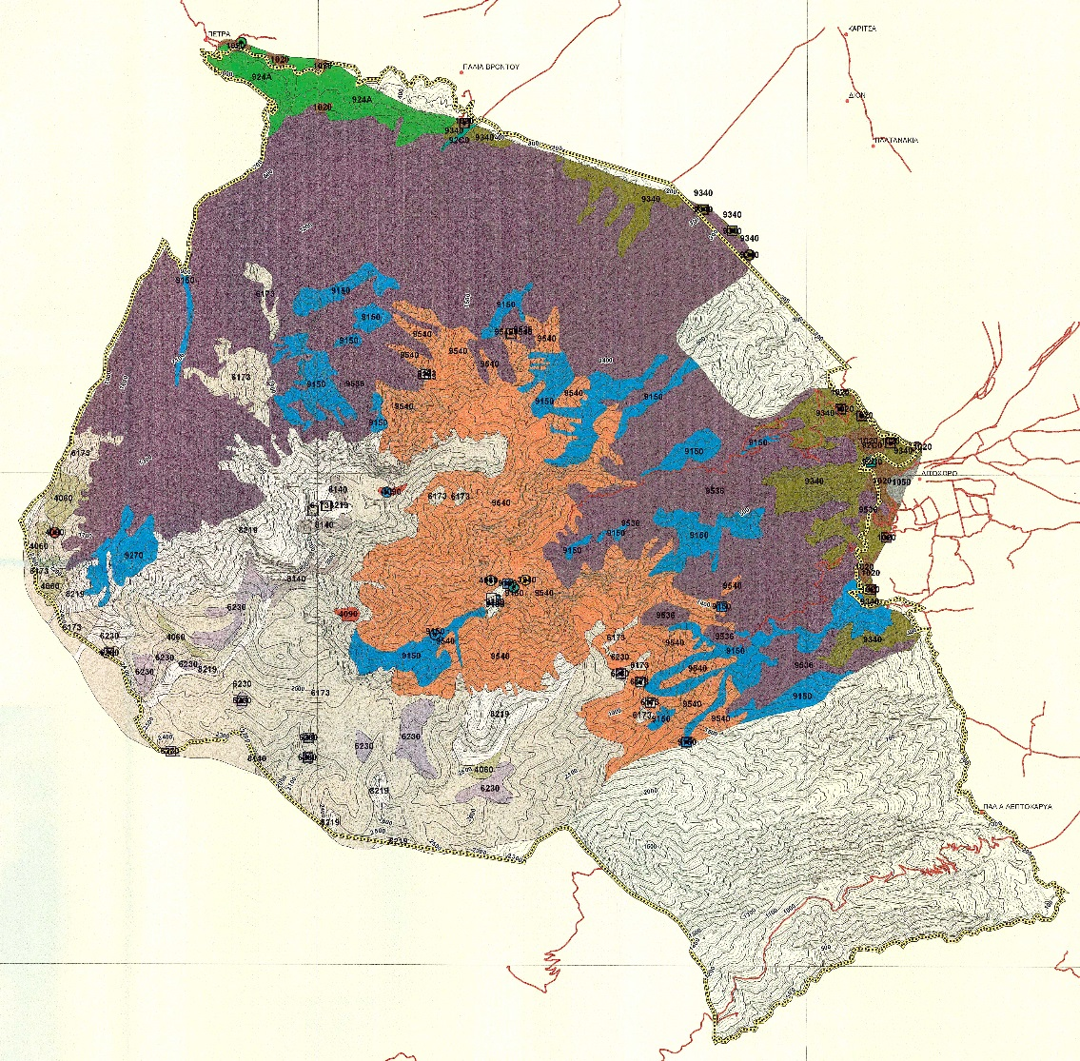
Legal framework
The first established National Park in
Hellas since 1938. (also Parnassus national Park
was established that year)
The Olympus National Park
Management Agency is a body governed
by private law and was established in 2002
The whole Olympus has been declared
an archaeological and historical place in
order to preserve its monumental and
historical physiognomy
Under the NATURA 2000 network
code GR1250001-«Όρος Όλυμπος»

Slide 3
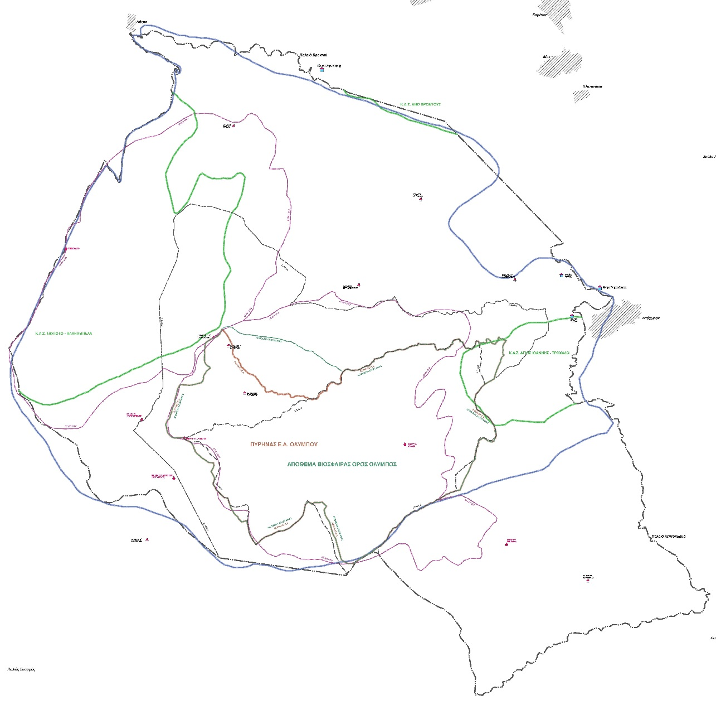
Declarations
The national park of mountain Olympus is a MaB Area since 1981
The core of the national park is a Biosphere Reserve

Slide 4
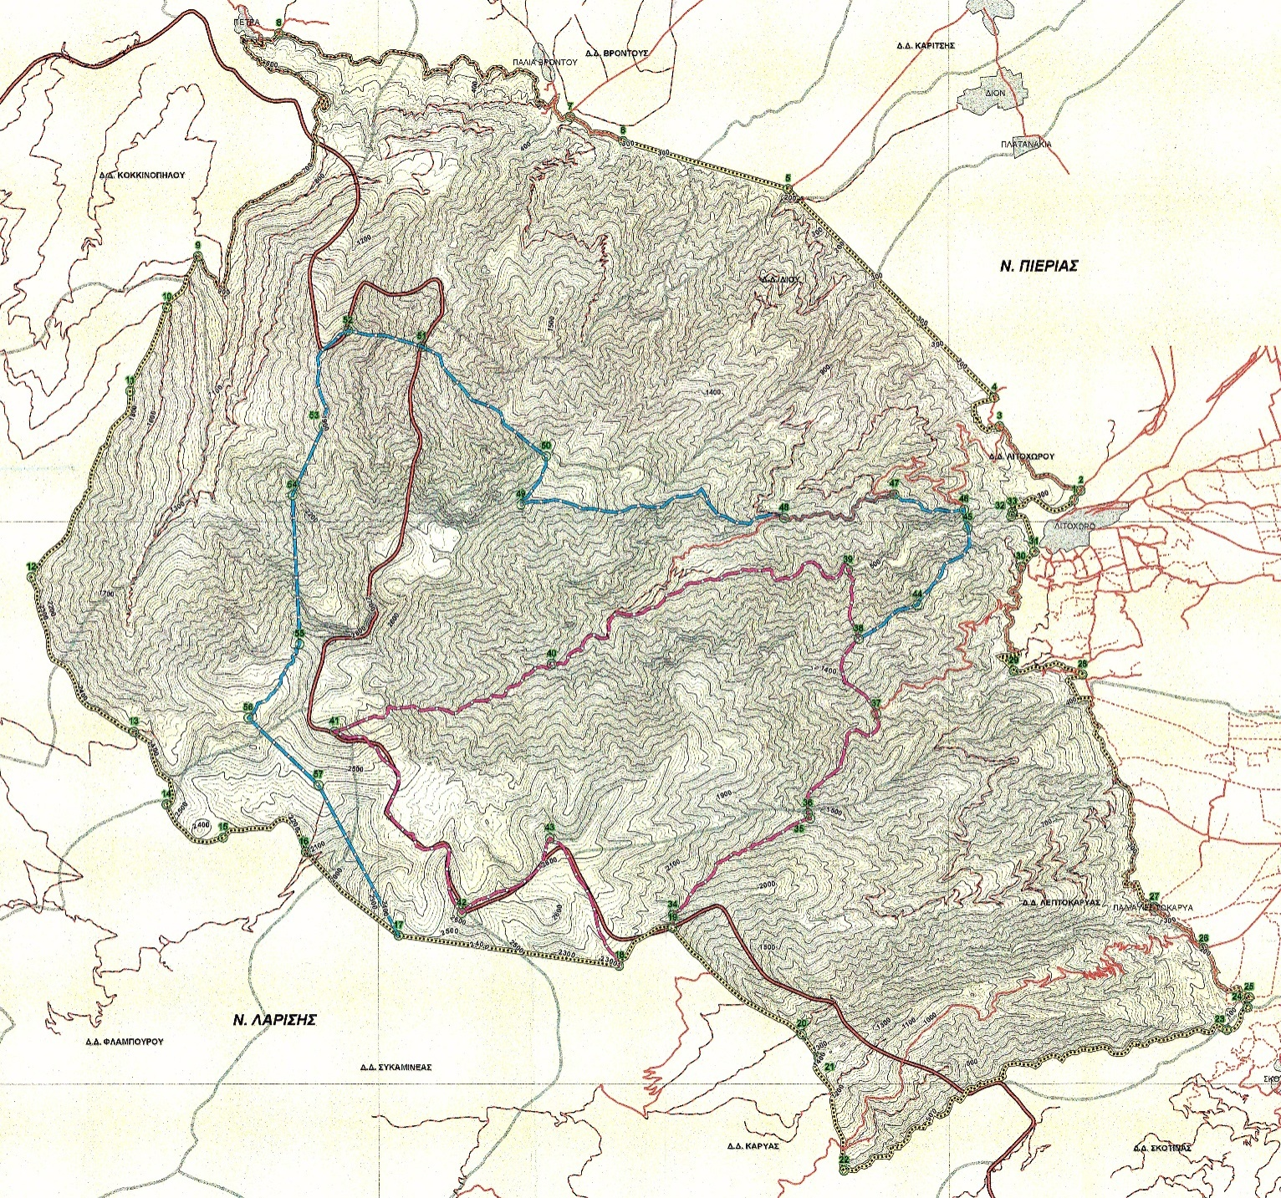
Zonation of the National Park

Slide 5
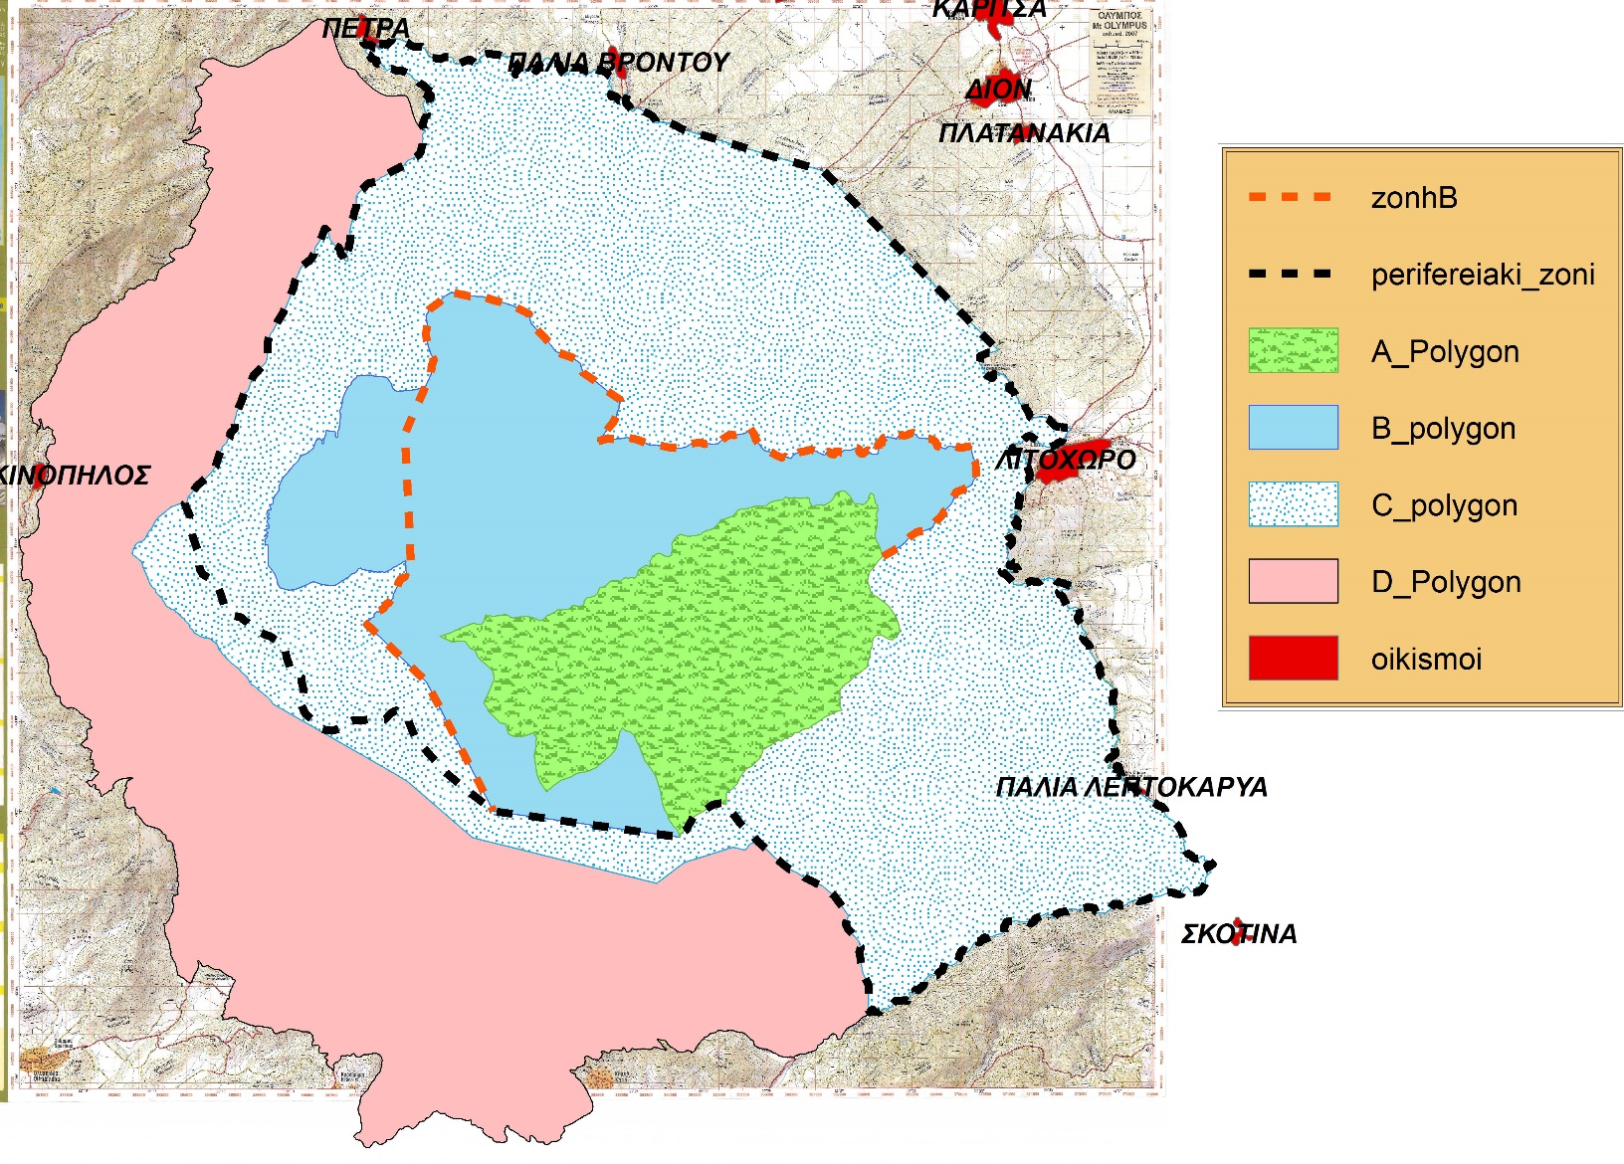
Suggested D Zone
The PA covers an area of 23,841 ha
Suggested zone D
Extend the limits of the PA South and west (to Thessaly)

Slide 6
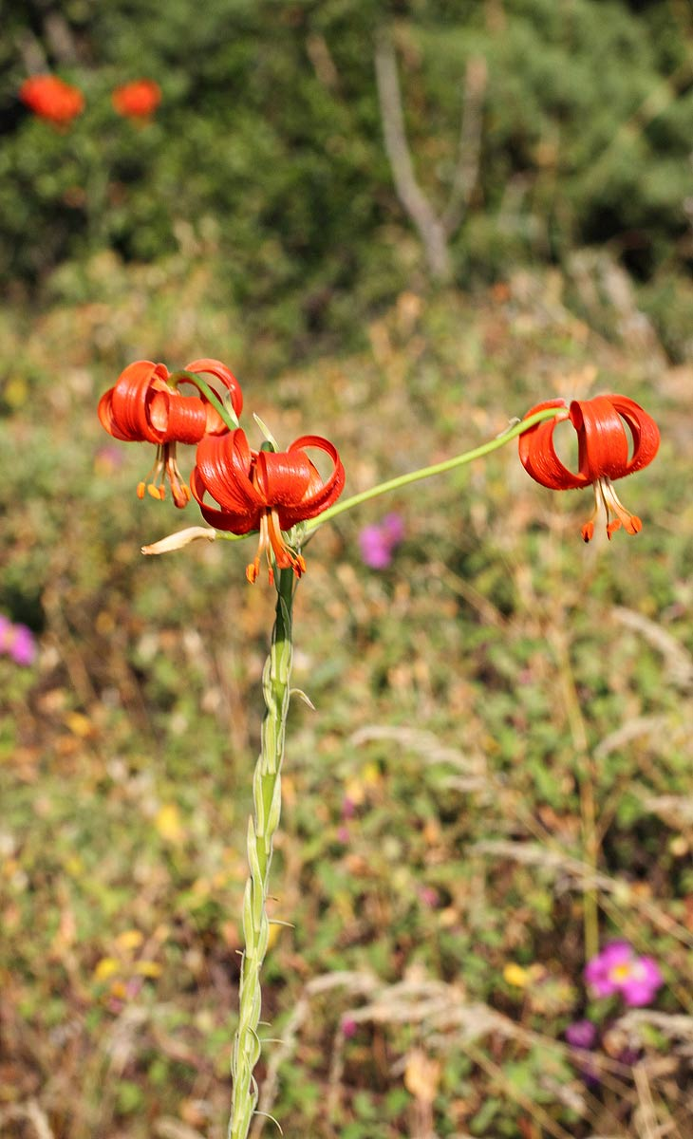
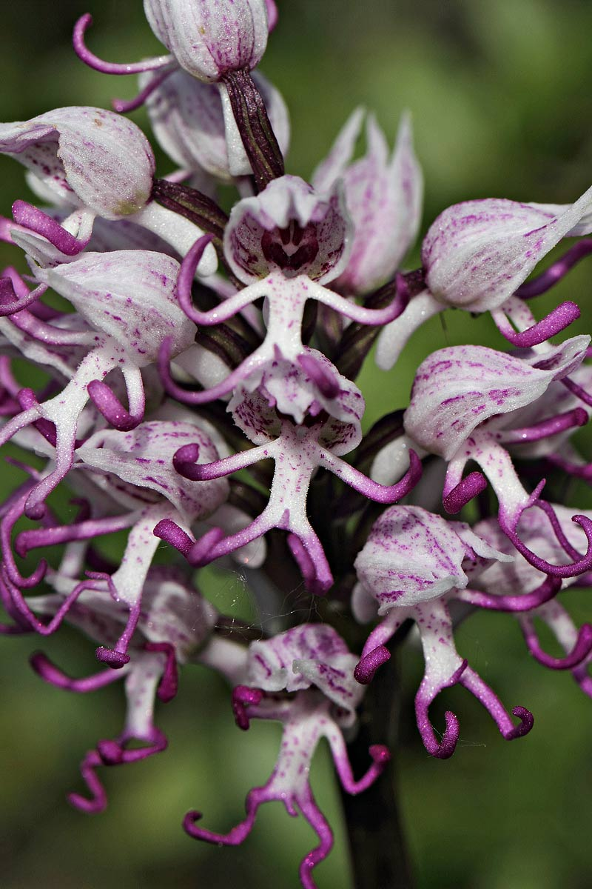
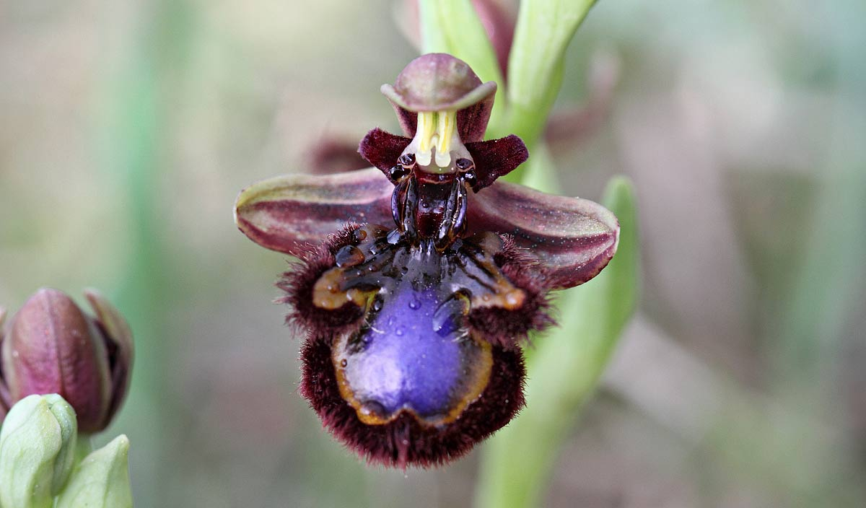
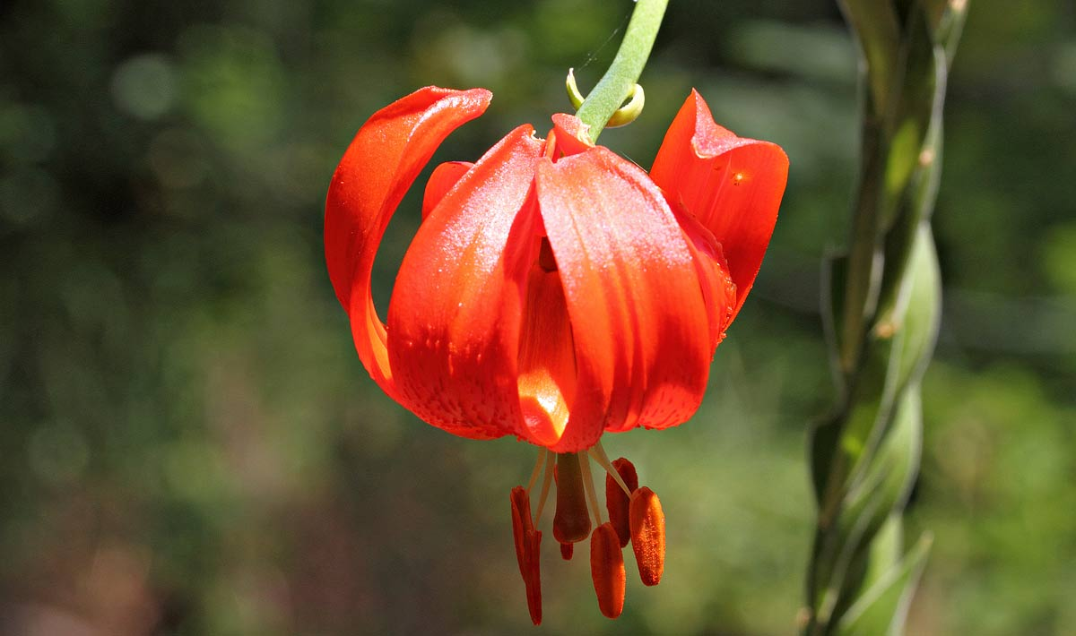
Orchis simia
Ophrys speculum
L. chalcedonicum

Slide 7
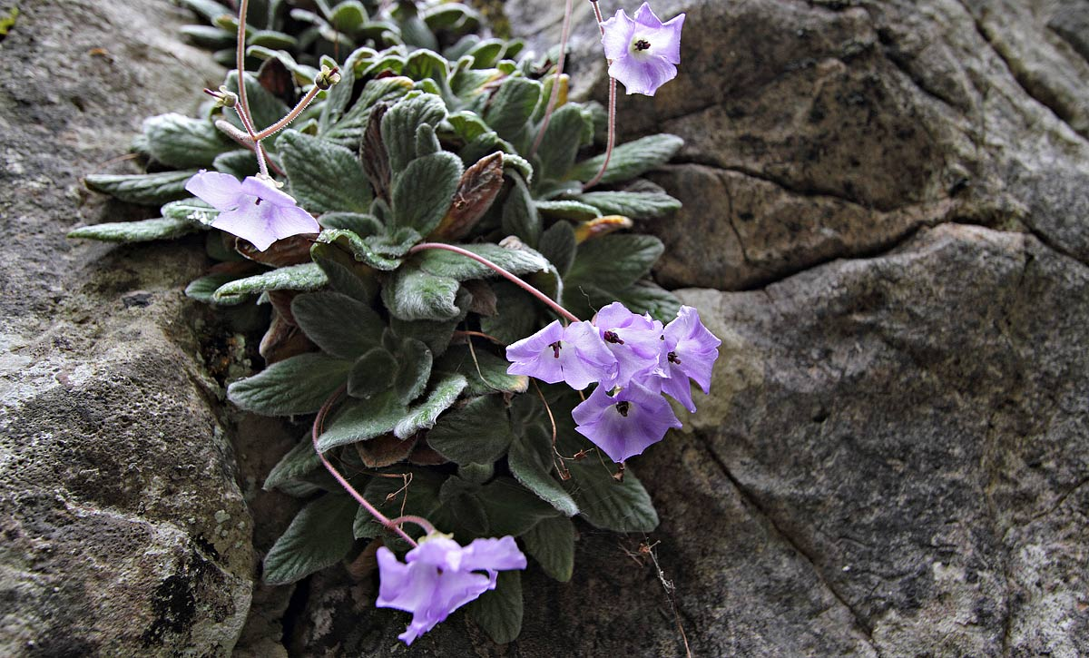
21 Endemic plants
Jankea heldreichii

Slide 8
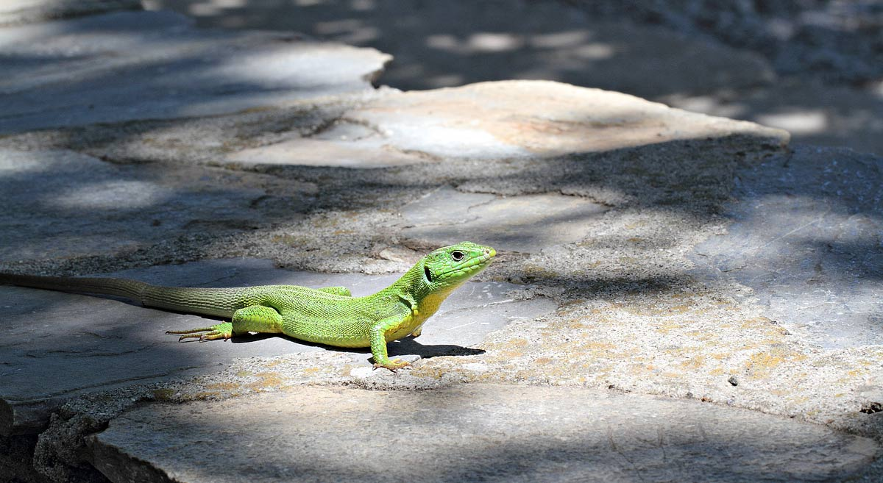
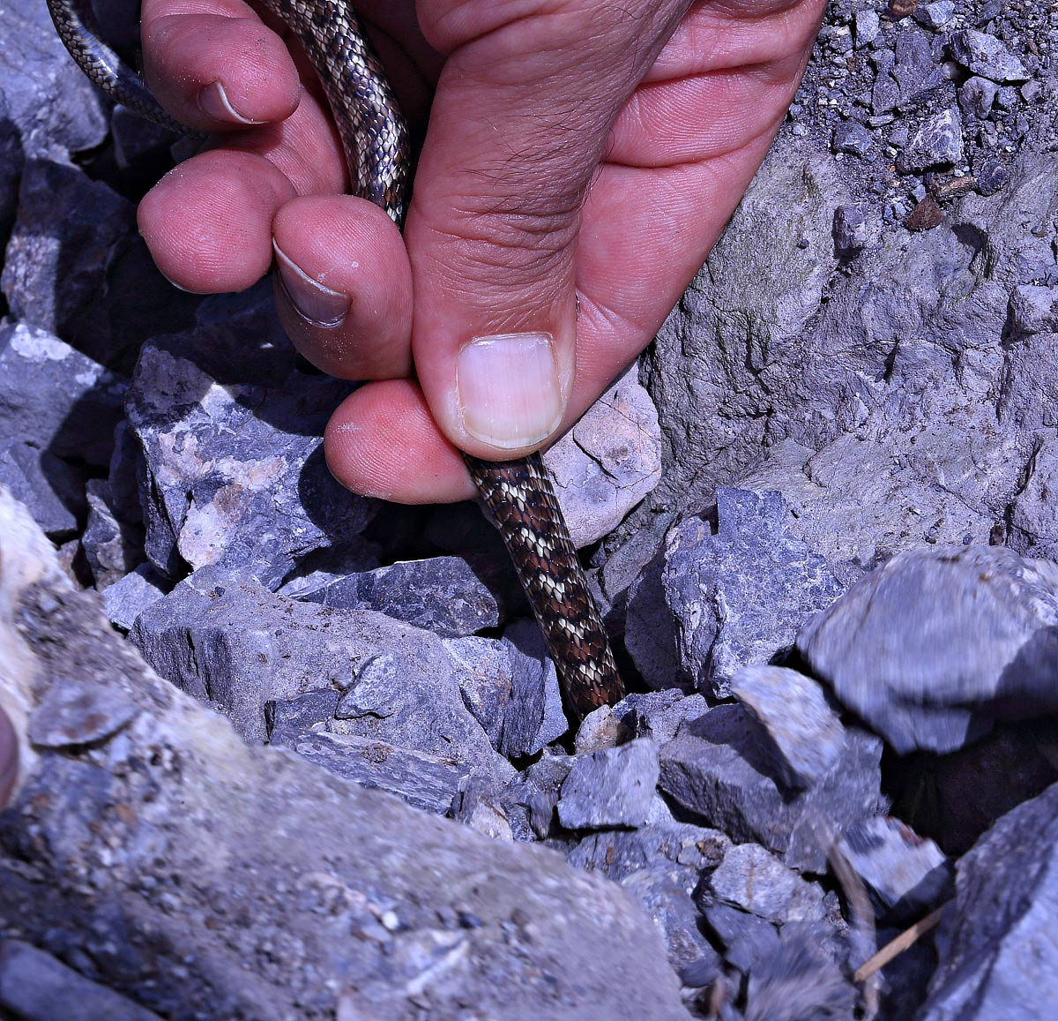
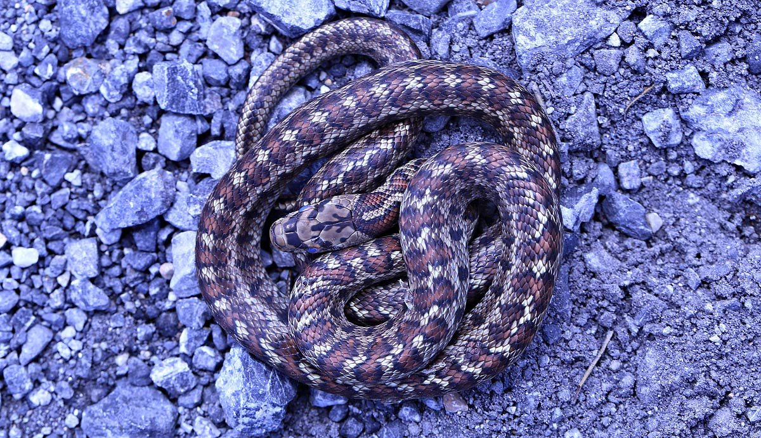
Lacerta trilineata-Balkan green lizard
Zamenis situla-European ratsnake
Zamenis situla-European ratsnake

Slide 9
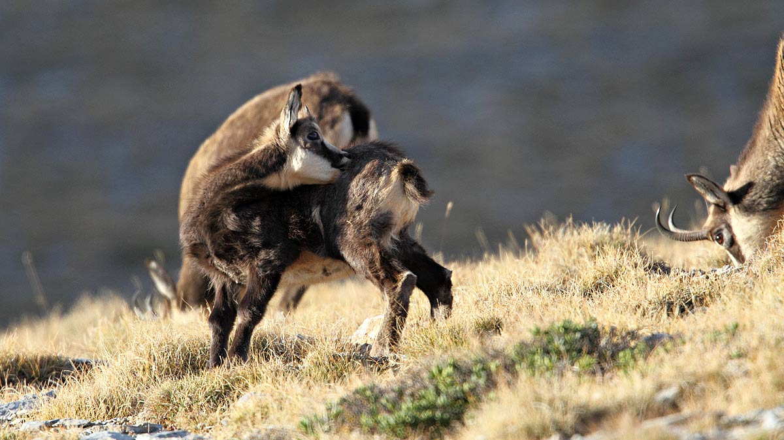
Balkan Chamois - Rupicapra rupicapra ssp balcanica (Linnaeus, 1758)

Slide 10
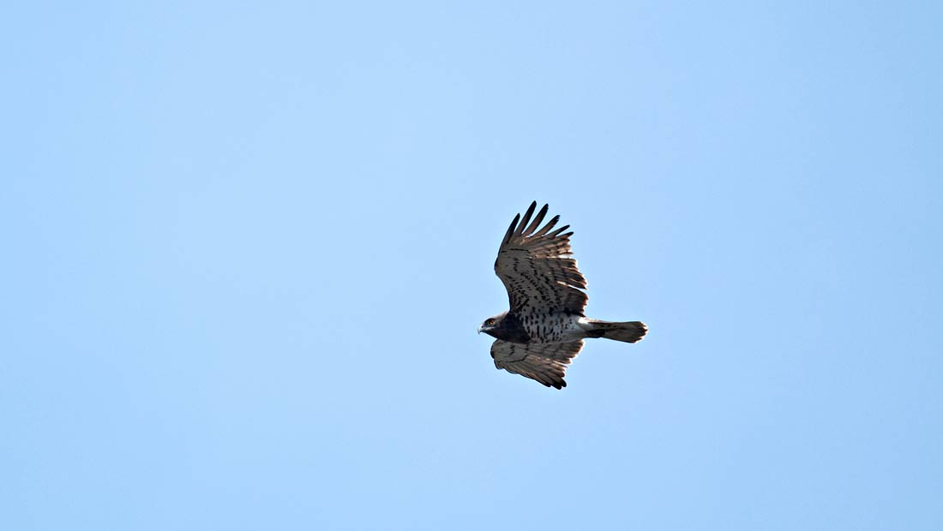
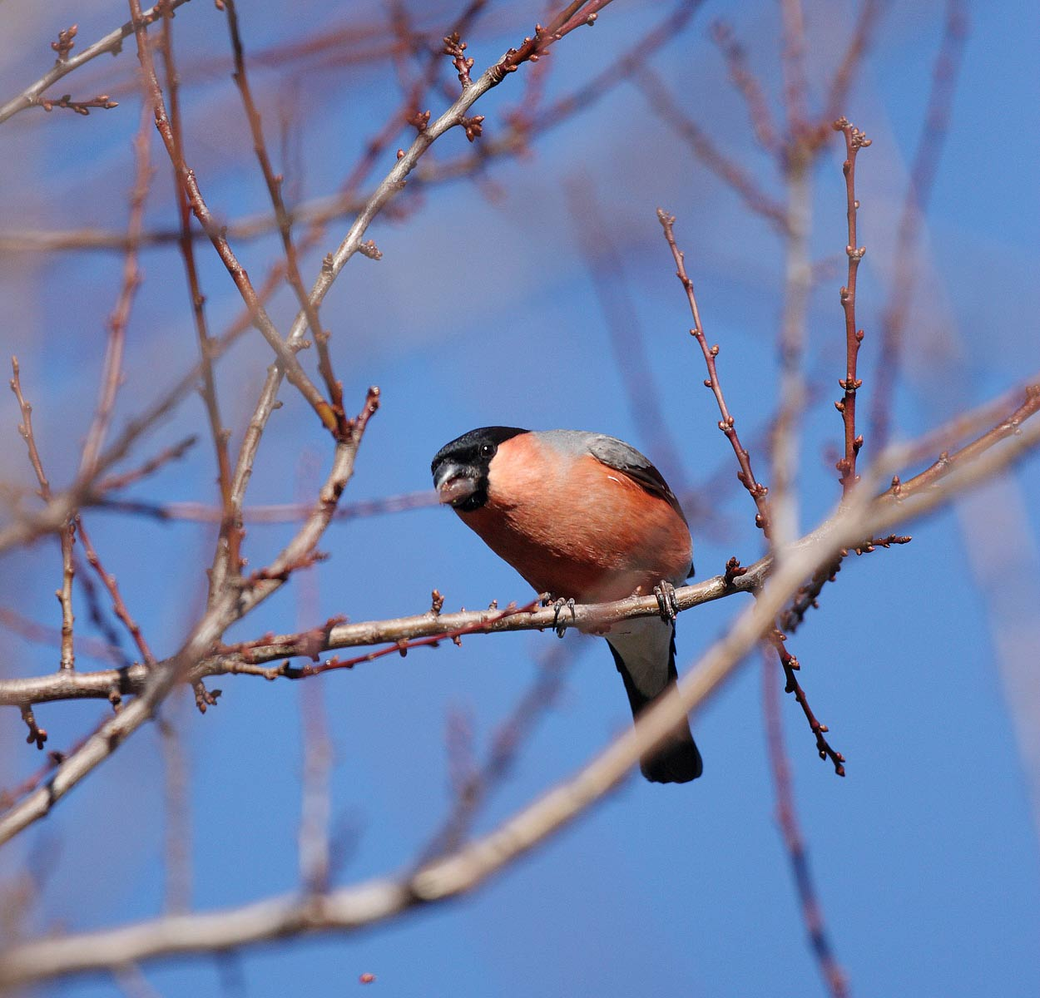
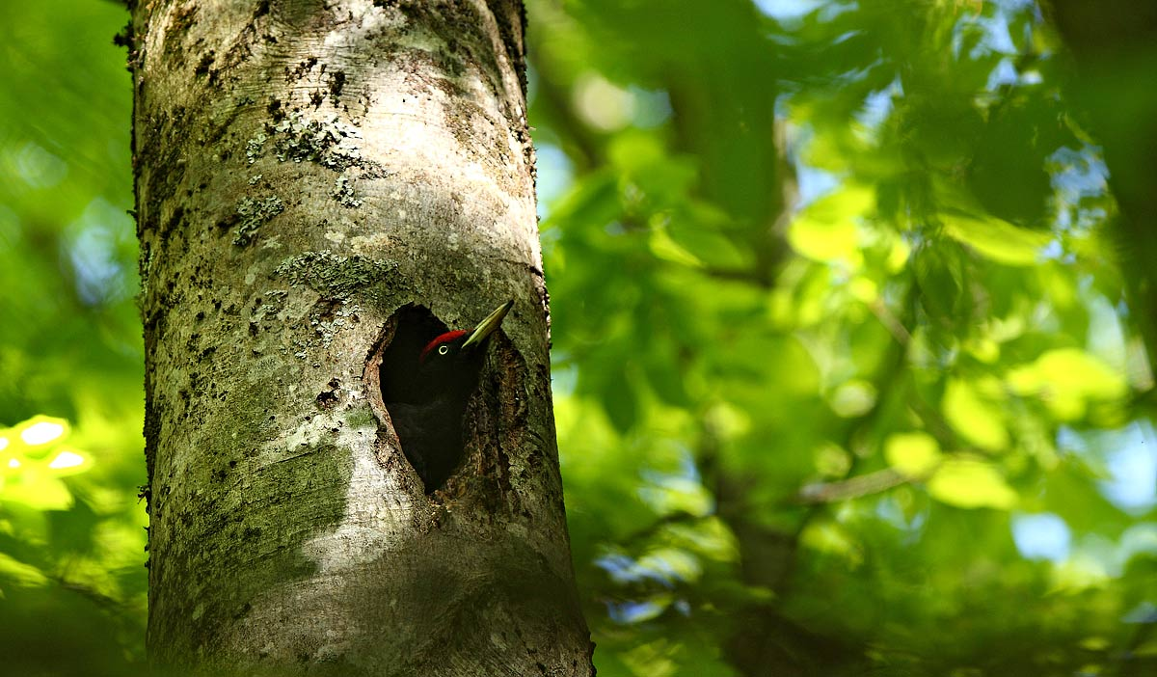
Circaetus gallicus-Short-toed Snake-eagle
Pyrhulla pyrhulla – Bullfinch
Dryocopus martius-Black woodpecker

Slide 11
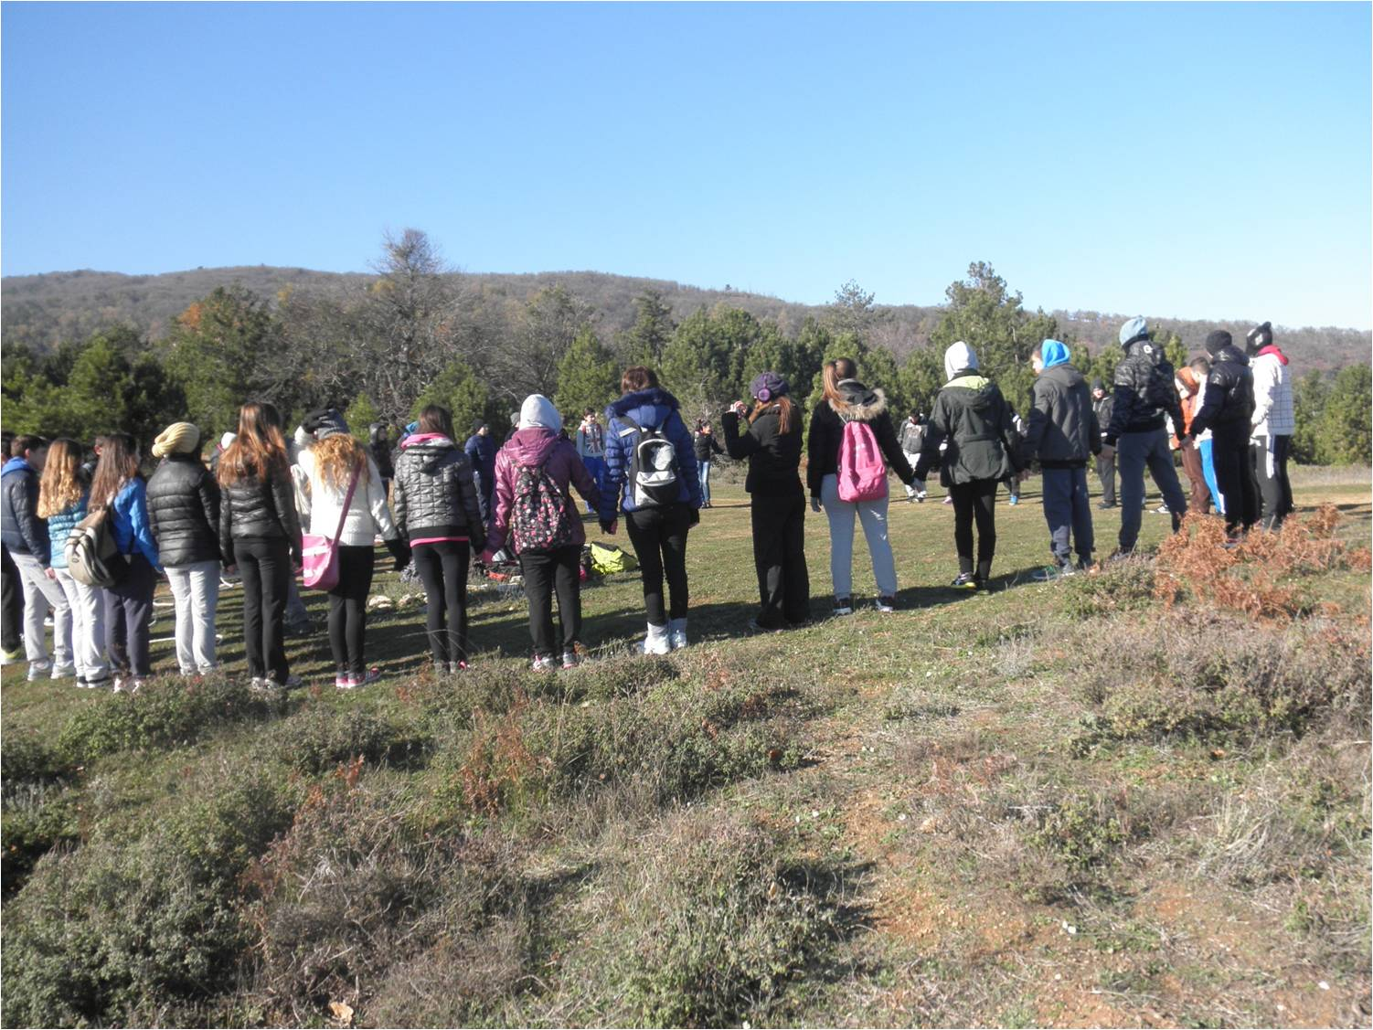
Collaborate with the two EEC in Litochoro and Palaios Panteleimonas in hosting and training students in the PA

Slide 12
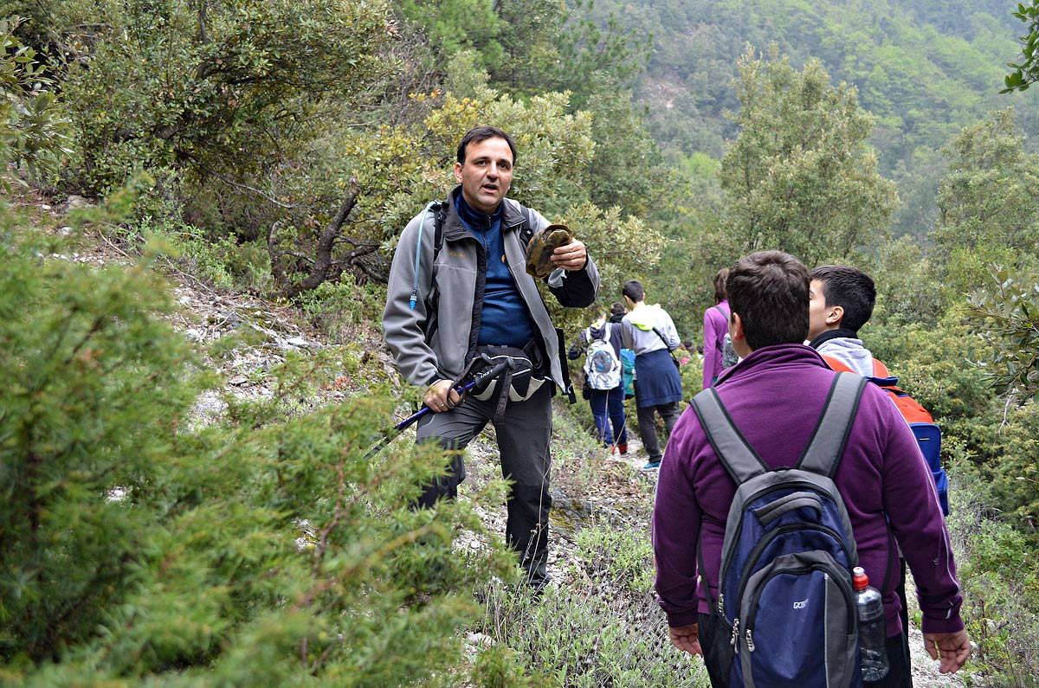

Slide 13
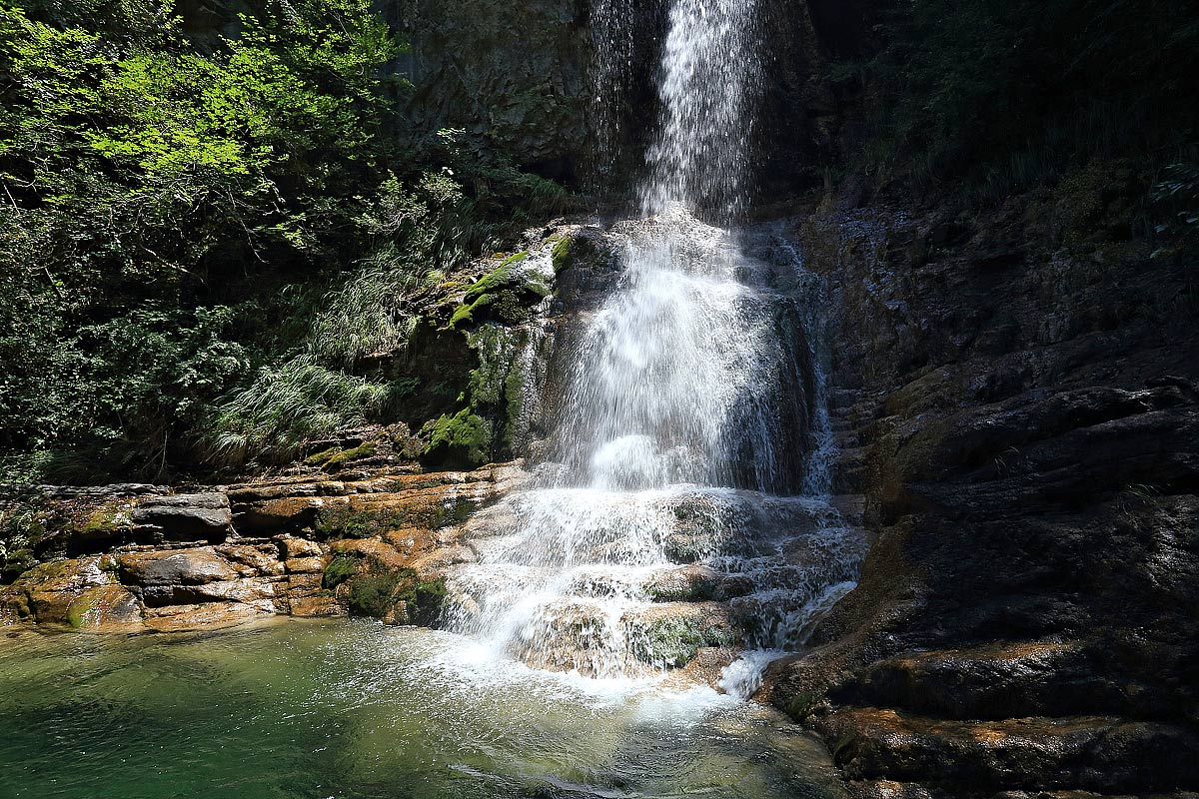

Slide 14
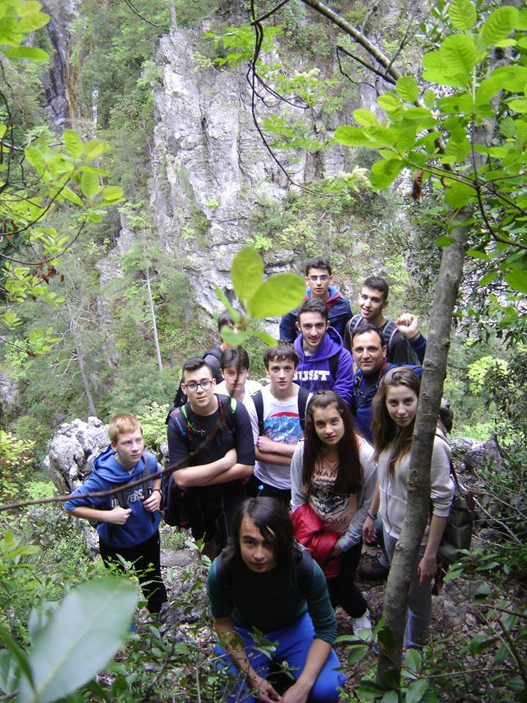

Slide 15
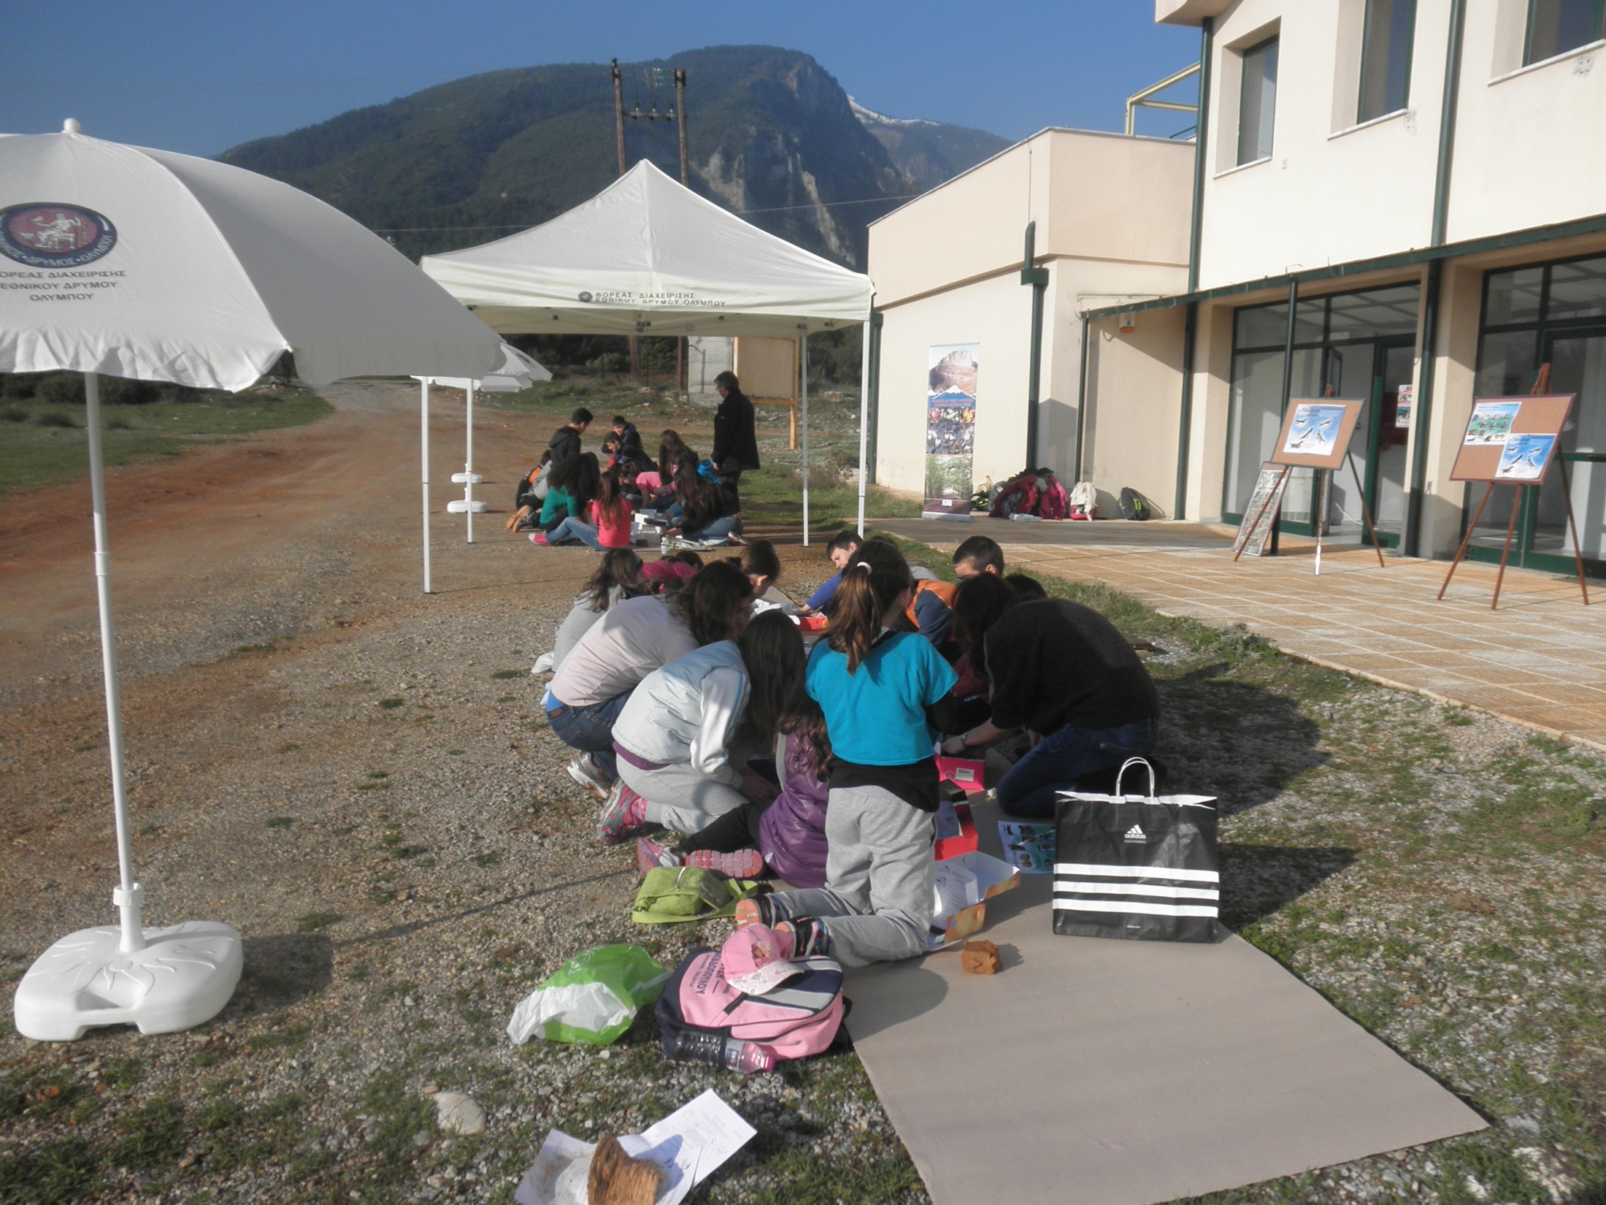
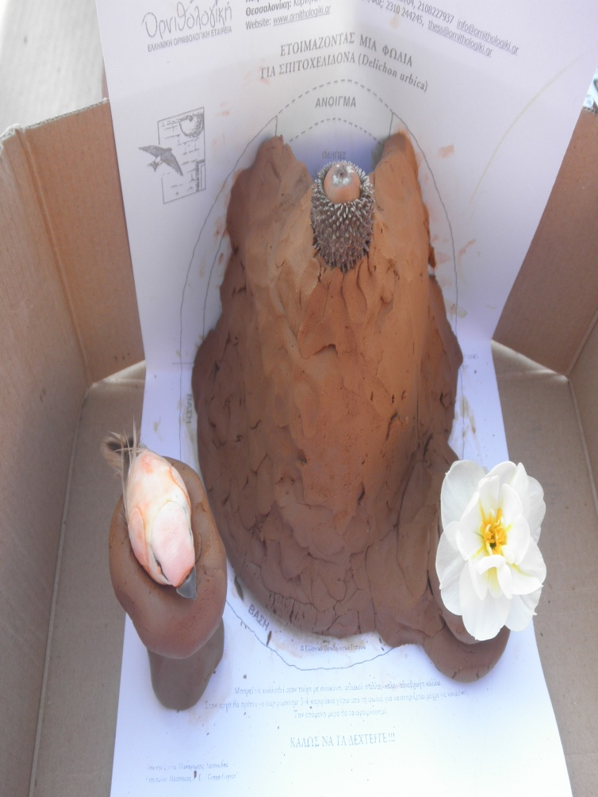

Slide 16
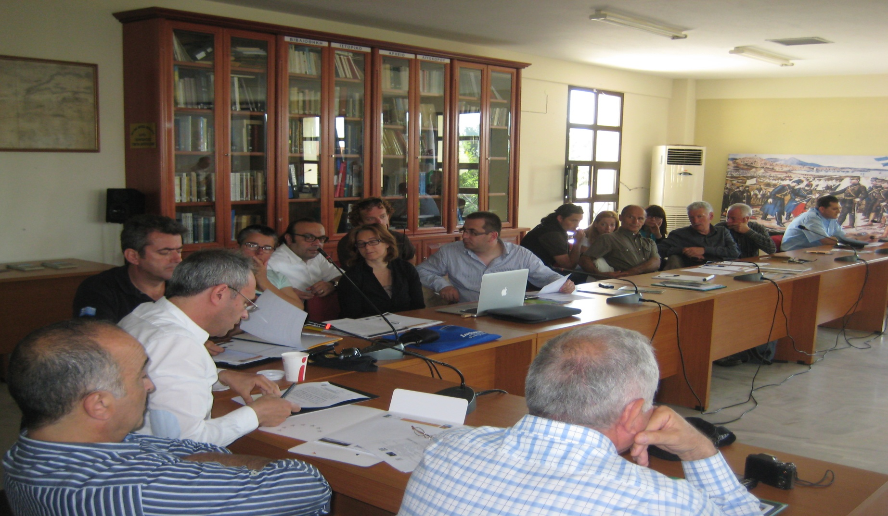
Technical workshop with the Network of Emblematic
Mediterranean Mountains for organizing Mountain running games in PAs

Slide 17
Please watch once more the movie: http://www.youtube.com/watch?v=z- ODS2rHGZQ and send me your comments at savvasv7@otenet.gr as to whether this video promotes Sustainability
http://www.olympusfd.gr: For all the needed info or to arrange a visit to the National Park of Mountain Olympus

Slide 18
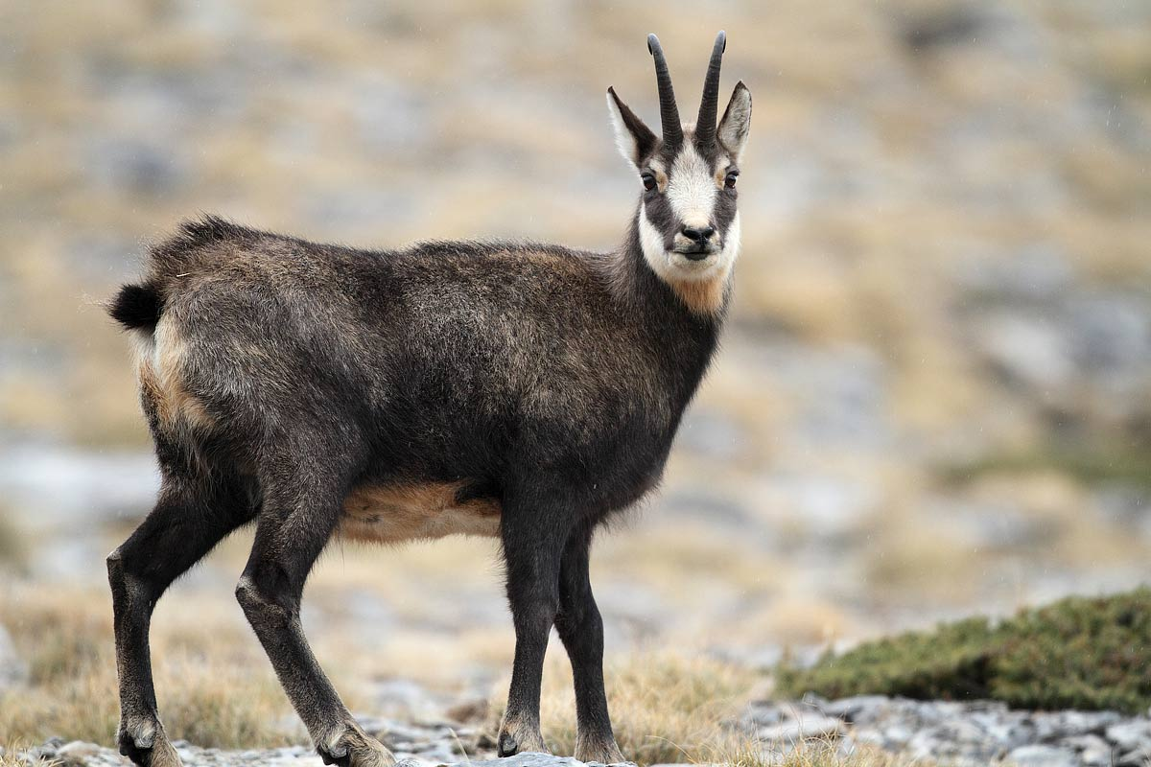
Thank you for your attention!

