Slide 1
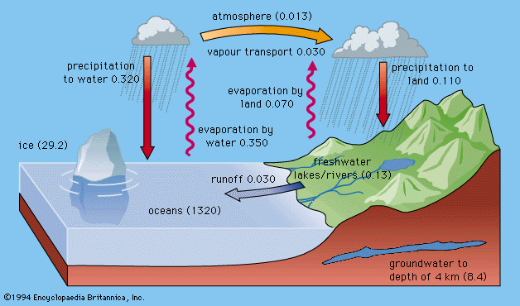
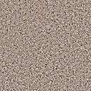

Groundwater
The Unseen Part of the Water Cycle
Ground Water
Reservoir
Salt Groundwater
The present-day surface hydrologic cycle. The numbers in parentheses refer to volumes of water in millions of cubic kilometres,
and the fluxes adjacent to the arrows are in millions of cubic kilometres of water per year.

Slide 2
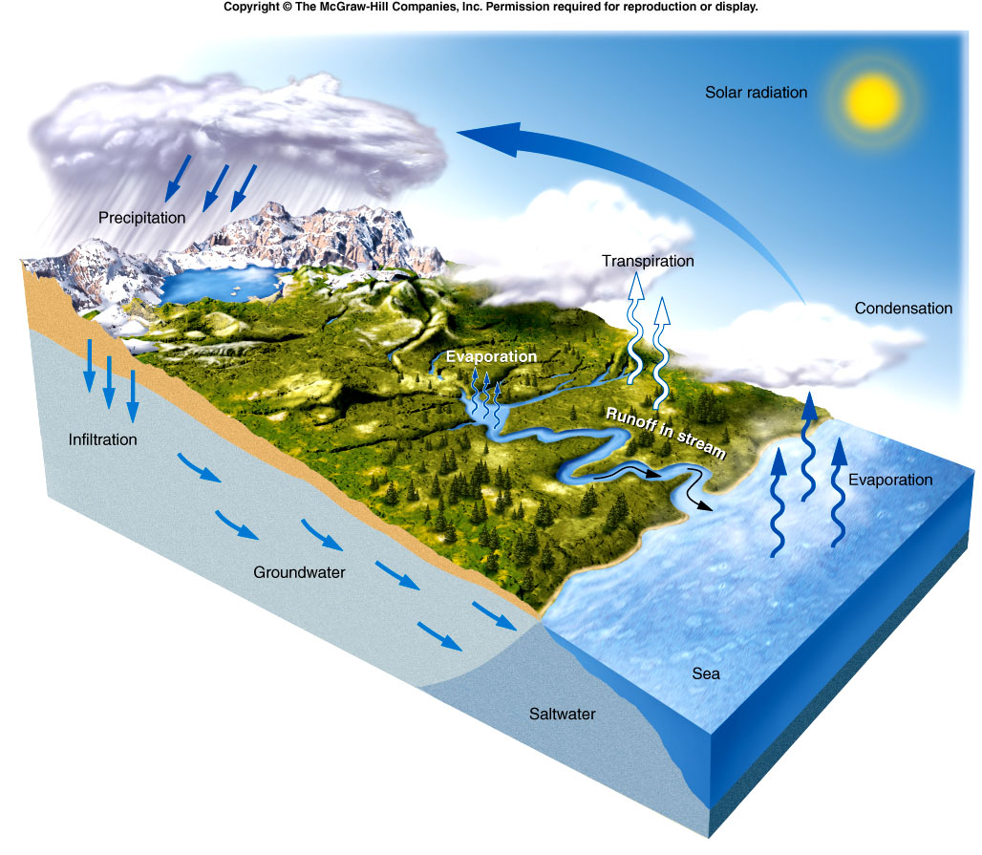
Most available fresh water is ground water
Atmosphere
0.0001%
Streams and Lakes
0.01%
(3%)
Oceans
97.2%
0.61%
(97%)

Slide 3
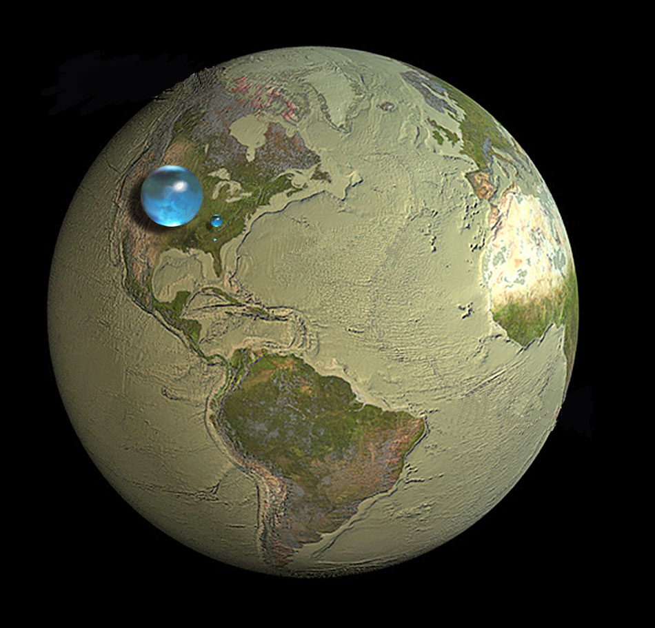
The largest sphere represents all of Earth's water, and its diameter is about 1384Κm- (1,386,000,000 cubic kilometers (km3). The sphere includes all the water in the oceans, ice caps, lakes, and rivers, as well as groundwater, atmospheric water, and even the water in you, your dog, and your tomato plant.
How much water is on Earth?
Liquid fresh water
The blue sphere represents the world's liquid fresh water (groundwater, lakes, swamp water, and rivers). The volume comes to about (10,633,450 km3), of which 99 percent is groundwater, much of which is not accessible to humans. The diameter of this sphere is about (272.8 kilometers).
Water in lakes and rivers
That one represents fresh water in all the lakes and rivers on the planet. The volume of this sphere is about (93,113 km3). The diameter of this sphere is about (56.2 kilometers).

Slide 4
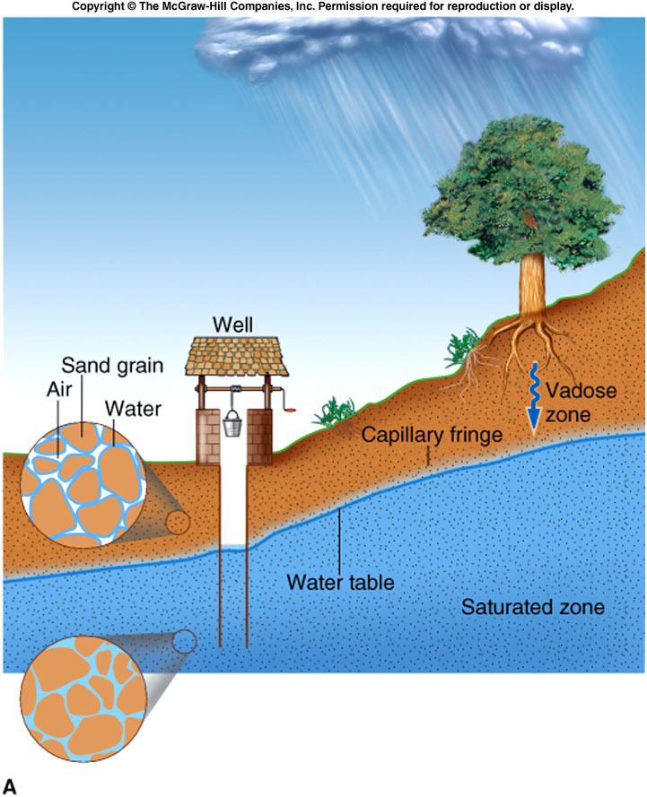
The Water Table
Aquifer: Saturated sediment or porous rock that is sufficiently permeable to supply useable amounts of water
Fig. 13.3

Slide 5
The Water Table
Water table: the surface separating the vadose zone from the saturated zone.
Measured using water level in well
Fig. 13.3

Slide 6
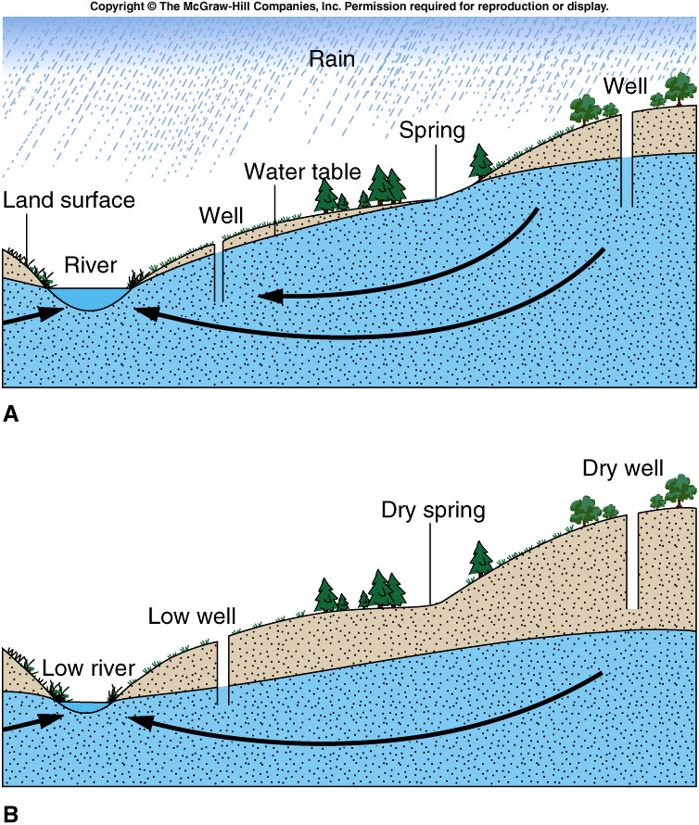
Groundwater Systems
Groundwater recharge: Infiltration percolating to the water table
Notes:
ΕΠΑΝΑΦΟΡΤΙΣΗ ΥΠΟΓΕΙΩΝ ΝΕΡΩΝ-

Slide 7
Groundwater Systems
Infiltration: Precipitation soaking into the soil and moving into the subsurface
Notes:
ΔΙΕΙΣΔΥΣΗ-

Slide 8
Groundwater Systems
Groundwater discharge:
  Groundwater leaving the subsurface at
  Natural locations including streams springs and wetlands
  Artificial means like pumped wells and drains
Notes:
ΑΠΟΦΟΡΤΙΣΗ ΥΠΟΓΕΙΩΝ ΥΔΑΤΩΝ-

Slide 9
Ground-Water Flow
Precipitation
Infiltration
Ground-water recharge
Ground-water flow
Ground-water discharge to
  Springs
  Streams and
  Wells

Slide 10
Groundwater Systems
Groundwater Flow:
  groundwater moves through the small pore spaces
  from areas with a high water table
  to areas with a low water table

Slide 11
Groundwater Systems
Velocity is proportional to
  Permeability
  Slope of the water table
Inversely Proportional to
  porosity
Fast (e.g., cm per day)
Slow (e.g., mm per day)
Notes:
Η ΤΑΧΥΤΗΤΑ ΕΙΝΑΙ ΑΝΑΛΟΓΗ- Διαπερατότητα, Κλίση του υδροφόρου ορίζοντα
-Αντιστρόφως ανάλογη με το πορώδες του εδάφους

Slide 12
Natural Water Table Fluctuations
Infiltration
  Recharges ground water
  Raises water table
  Provides water to springs, streams and wells
Reduction of infiltration causes water table to drop
Notes:
ΔΙΗΘΗΣΗ- Επαναφορτίζει υπόγεια ύδατα -Ανεβάζει υδροφόρο ορίζοντα -Παρέχει νερό σε πηγές, ρυάκια και πηγάδια
Μείωση της διείσδυσης προκαλεί τον υδροφόρο ορίζοντα του νερού να πέσει.

Slide 13
Natural Water Table Fluctuations
Reduction of infiltration causes water table to drop
  Wells go dry
  Springs go dry
  Discharge of rivers drops
Artificial causes
  Pavement
  Drainage
Notes:
ΣΥΝΕΠΕΙΕΣ ΜΕΙΩΣΗΣ ΔΙΕΙΣΔΥΣΗΣ ΝΕΡΟΥ-
ΤΕΧΝΙΚΑ ΑΙΤΙΑ ΜΕΙΩΣΗΣ- Δόμηση -αποστράγγιση

Slide 14
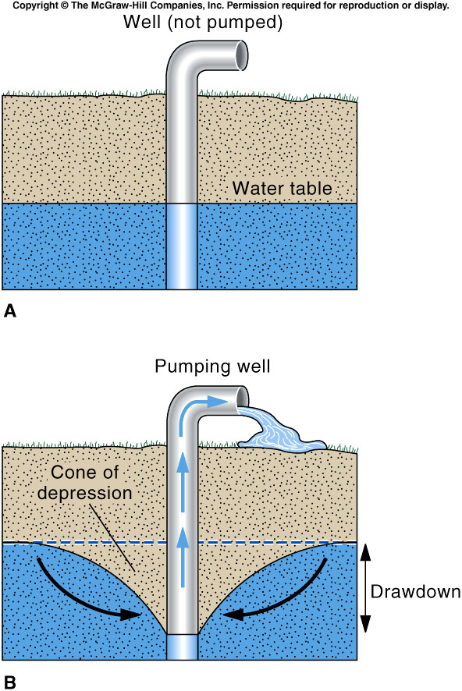
Effects of Pumping Wells
Pumping wells
  Accelerates flow near well
  May reverse ground-water flow
  Causes water table drawdown
  Forms a cone of depression
Notes:
Επιταχύνεται η ροη του νερού κοντα στην αντλια…

Slide 15
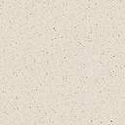
Effects of Pumping Wells
Dry well
Continued water-table drawdown
  May dry up springs and wells
  May reverse flow of rivers (and may contaminate aquifer)
  May dry up rivers and wetlands
Losing
Stream
Dry well
Dry well
Dry river

Slide 16
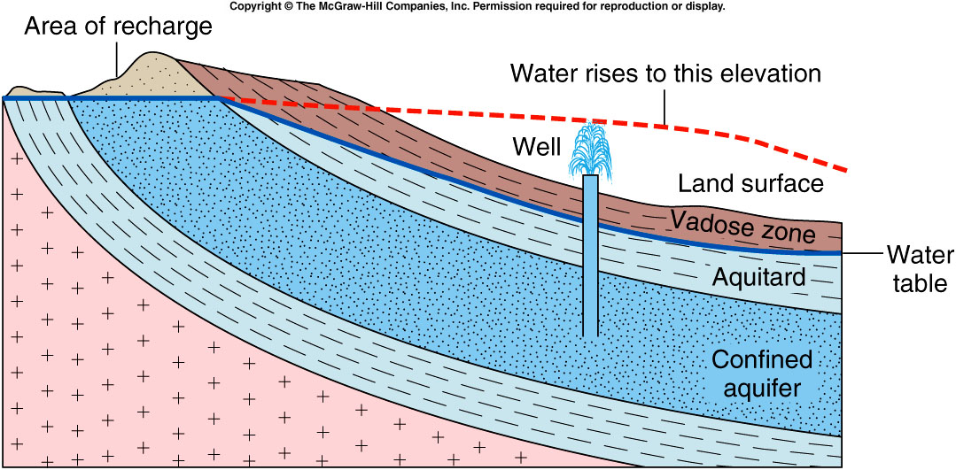
Confined Aquifers

Slide 17
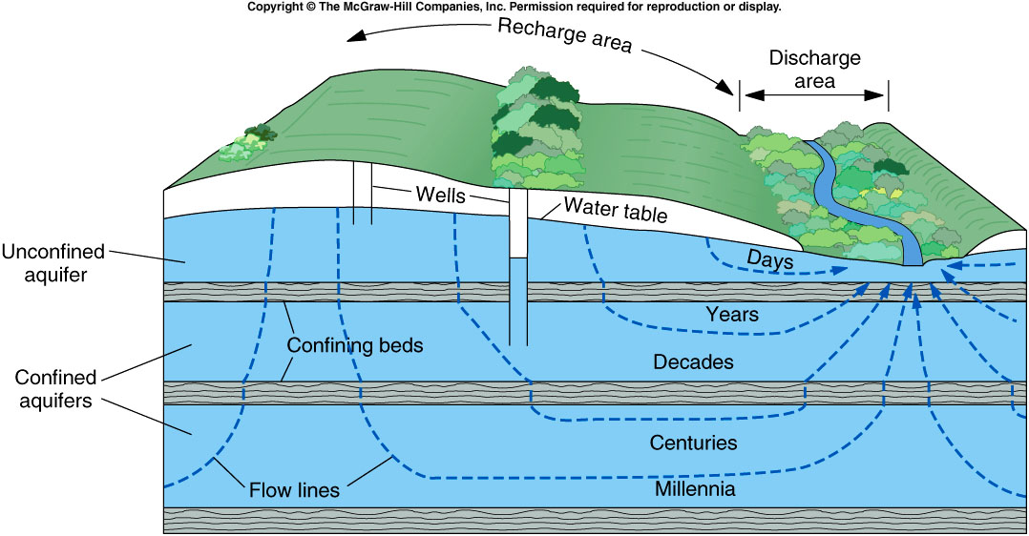
Confined Aquifers

Slide 18
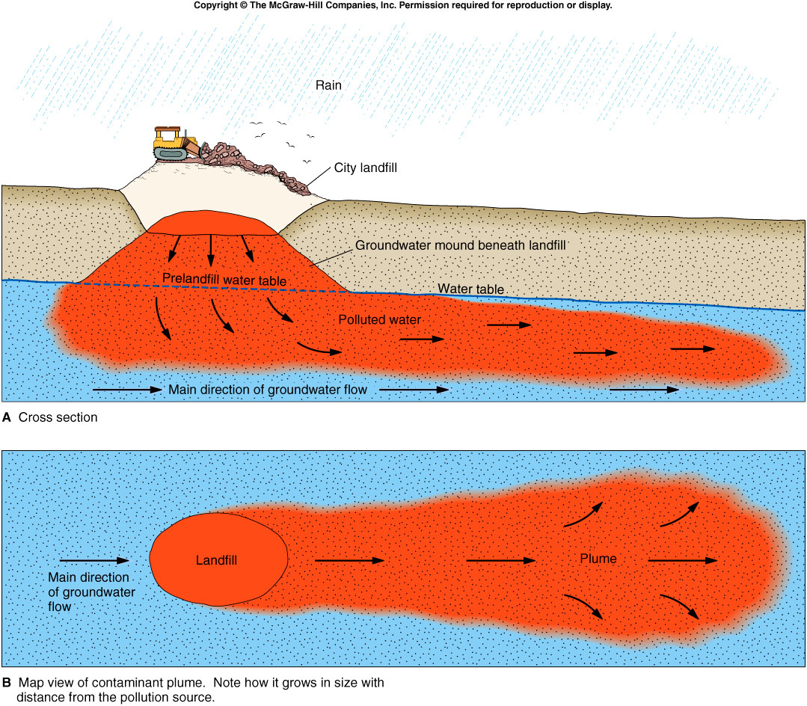
Ground-Water Contamination
Dissolved contamination travels with ground water flow
Contamination can be transported to water supply aquifers down flow
Pumping will draw contamination into water supply

Slide 19
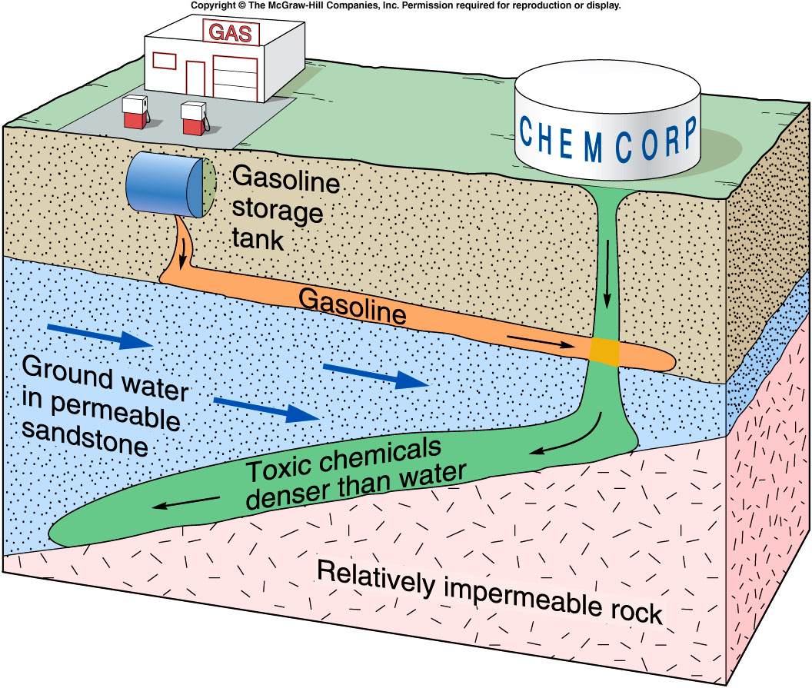
Ground-Water Contamination
Leaking Gasoline
  Floats on water table
  Dissolves in ground water
  Transported by ground water
  Contaminates shallow aquifers

Slide 20
Ground-Water Contamination
Dense solvents
  E.g., dry cleaning fluid (TCE)
  Sinks past water table
  Flows down the slope of an impermeable layer
  Contaminates deeper portions of aquifers

Slide 21
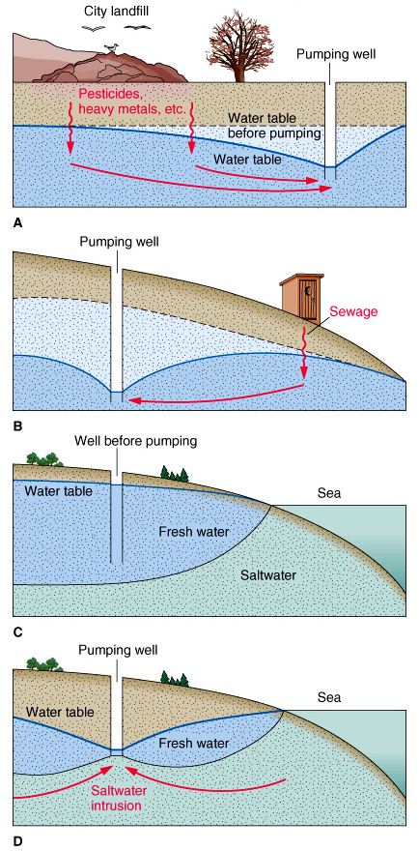
Ground-Water Contamination
Effects of pumping
  Accelerates ground water flow toward well
  Captures contamination within cone of depression
  May reverse ground water flow
  Can draw contamination up hill
  Will cause saltwater intrusion

Slide 22
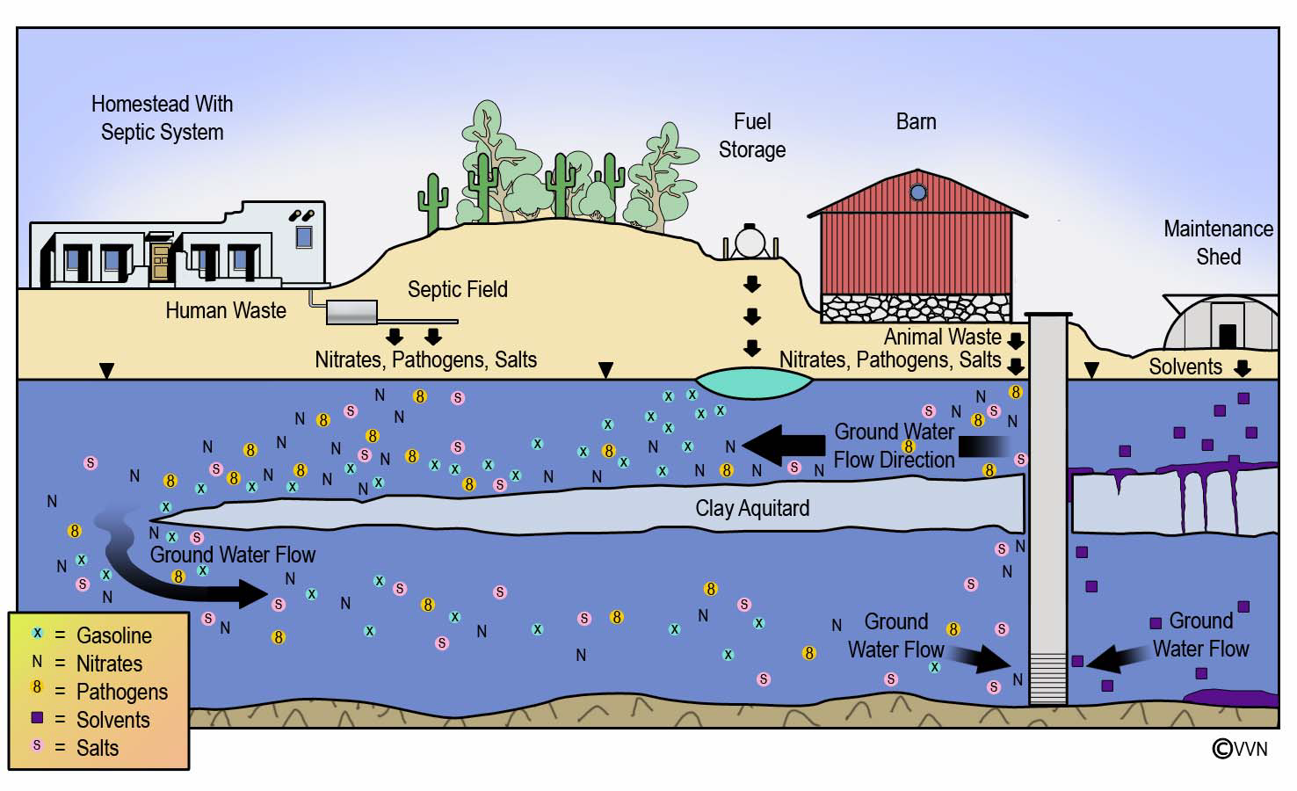
Ground-Water Contamination

